Slide 1

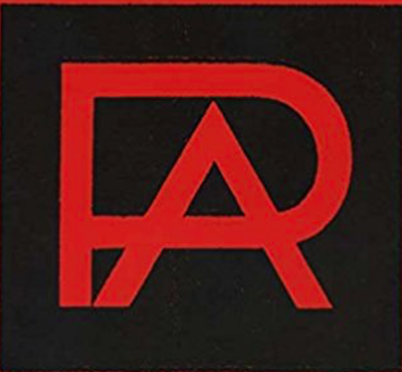
Alexander Rodchenko
Russian Constructivism

Slide 2
Alexander Rodchenko
Born in Russia in 1891 Rodchenko became an artist and designer of many mediums including painting, photography, sculpture, advertising and packaging. Heavily influenced by the upheaval surrounding the Russian revolution of 1917, he was one of the most prolific constructivist artists of the period. He was also a member of the Productivists, which pushed for the introduction of art into every day life, a concept which in many ways describes modern day graphic design
Russian Constructivism

Slide 3
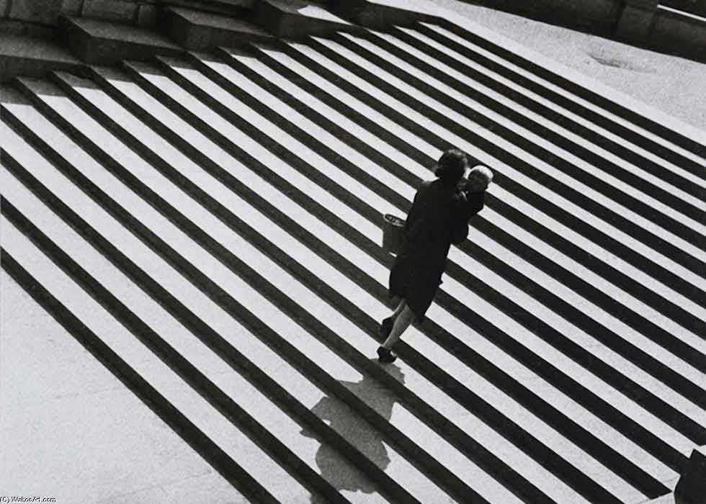

Slide 4
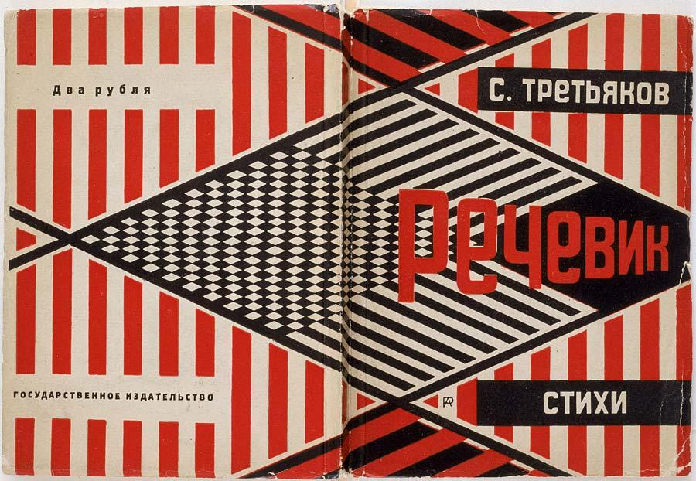

Slide 5


Slide 6


Slide 7


Slide 8


Slide 9


Slide 10


Slide 11
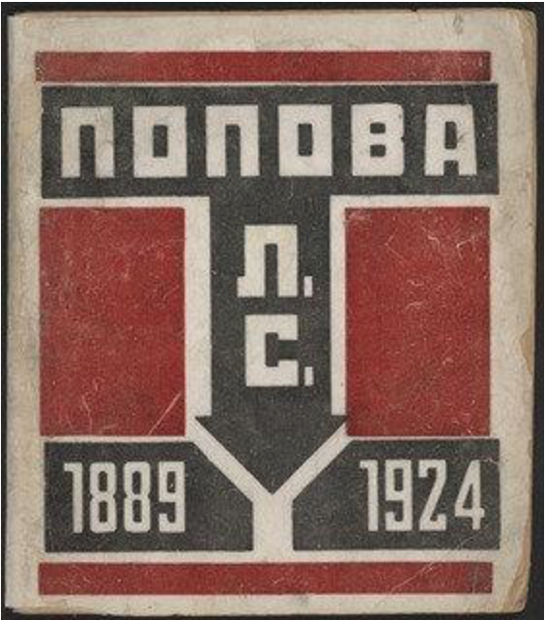

Slide 12


Slide 13


Slide 14


Slide 15


Slide 16


Slide 17


Slide 18


Slide 19


Slide 20


Slide 21


