Slide 1


Design Thinking: What Is It?
Notes:
thinking behind innovation
Select historic examples, not necessarily a chronology
What form or look does innovation take

Slide 2
Design Thinking: Contextual Understanding
directing our use of technology
What influences Innovation?
What can we learn from historic examples?
What form or look does innovation take?
Notes:
thinking behind innovation
Select historic examples, not necessarily a chronology
What form or look does innovation take

Slide 3
What is DESIGN THINKING?
Design Thinking Methodology is a specific form of inquiry. Its purpose is to analyze products or design styles according to an understanding of relevant contextual information. Conclusions can then be formed about the impact those design products have had on the design community as well as the wider world in which we all live.
It is creative thinking-in-action, the premise of which is, that if businesses know how designers approach problems, they can build on that understanding, and be better prepared to address issues specific to their industry. The result of successful Design Thinking is that innovation happens at a higher level—a paradigm shift occurs requiring:
Empathy for the context of a problem
Creativity in the generation of insights and solutions
Rationality in analyzing and finding various solutions (not just one)

Slide 4
What is ZEITGEIST?
Zeitgeist (spirit of time/place) is necessary to fully realize meaningful solutions. It is the result of all of the variables effecting the way people think and as a result, what they make and how they communicate.
Primary influences of Zeitgeist are:
Culture (customs, social forms, & material traits shared by a group)
Geography (where we live)
Belief Systems (religion)
Political Influence (government)
Economics (production, distribution, consumption)
Technology (inventions)
pacificgraphicdesign.
wordpress.com/
courses/history-of-graphic-design/design-thinking/

Slide 5
DESIGN is always changing. It continually transforms how we engage with each other in new and exciting ways.
New processes, strategies and technologies are invented.
Historical precedents are re-evaluated and critiqued.
Innovative storytelling and narrative techniques are formed.
What do we learn from this constant process of change, actively reshaping the creative process, directing currents in contemporary culture, and redefining the meaning of our world?
AIGA, Chicago

Slide 6
Health Care
From about 1340 until 1380, a bubonic plague, or Black Death, spread throughout Medieval Europe killing more than 25 million Europeans. This horrible event demanded multiple changes for civilization to survive.
By the early 1500s, as a sanitary measure one such change required that all food and beverage containers, including the common drinking mug, be covered. This was accomplished by adding a hinged lid with a thumb lift and became the distinctive German beer stein.
Notes:
Zeitgeist characterized mostly by the plague affected religious beliefs, customs, art and technology

Slide 7
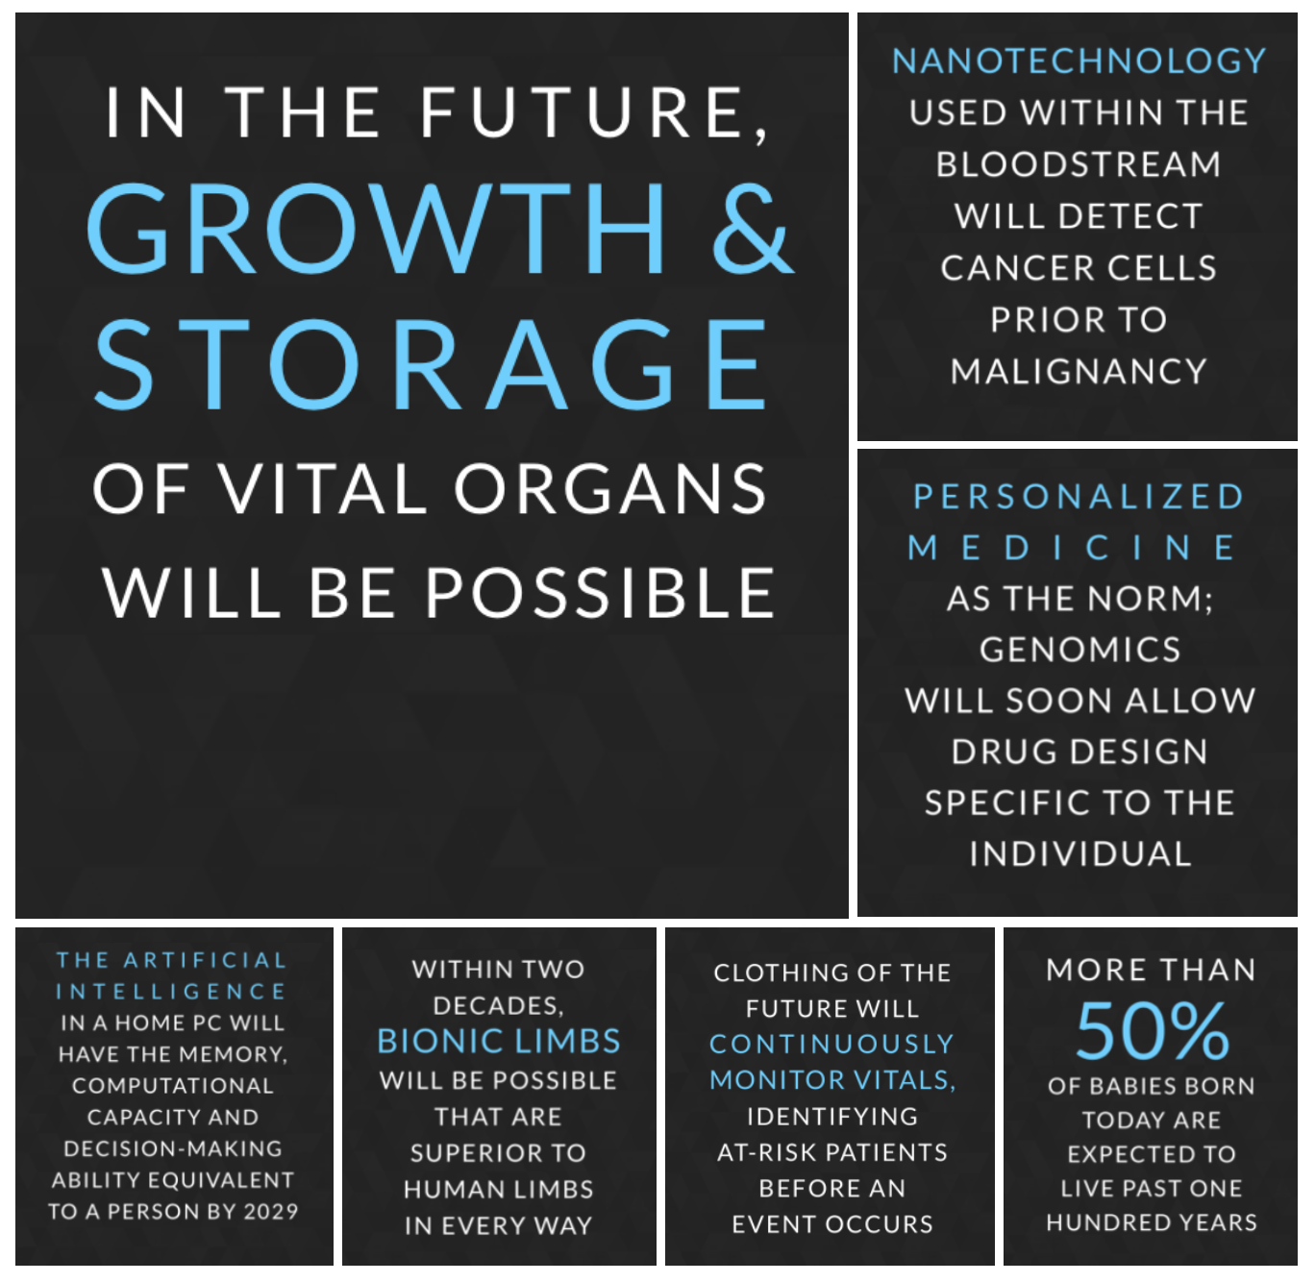
Wall Street Journal
2016

Slide 8
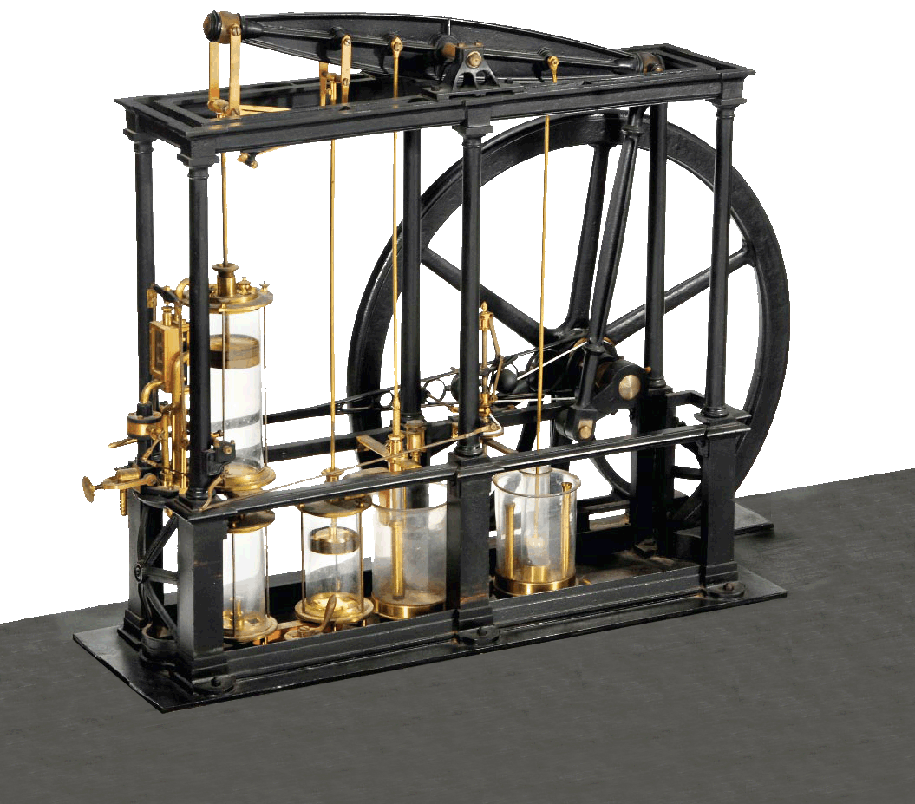
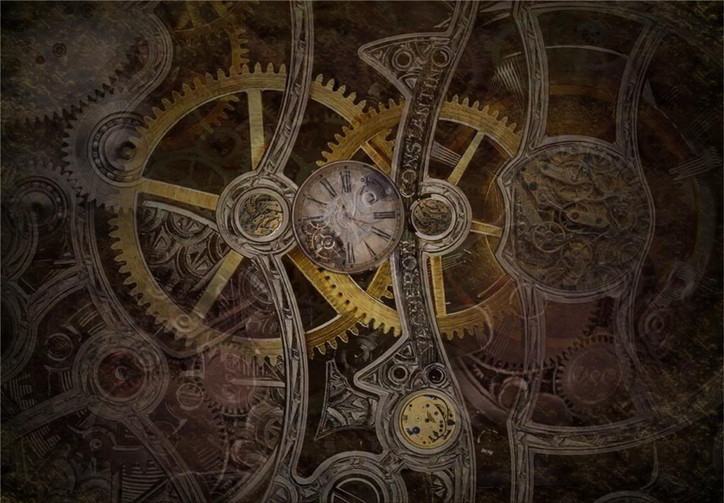
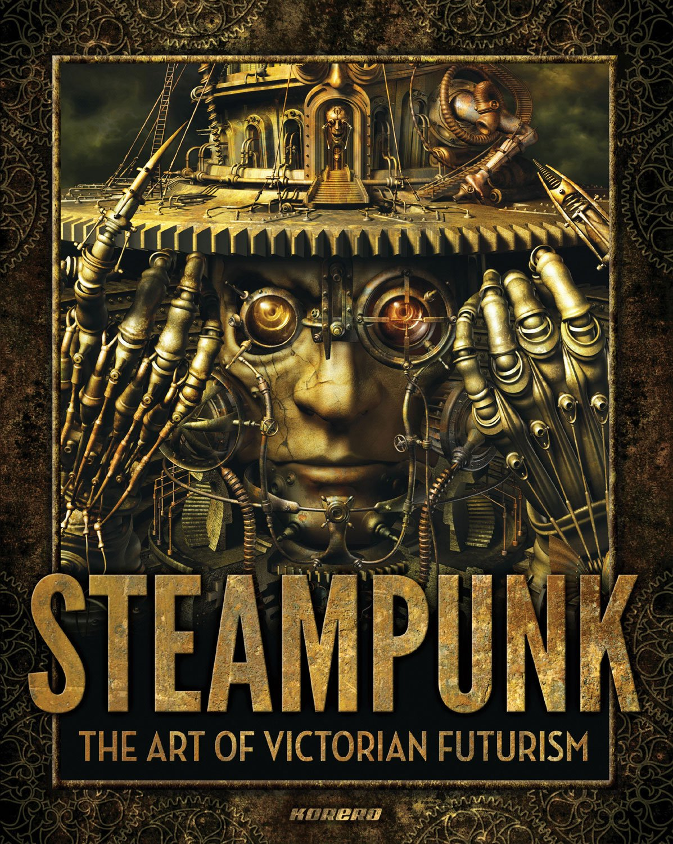
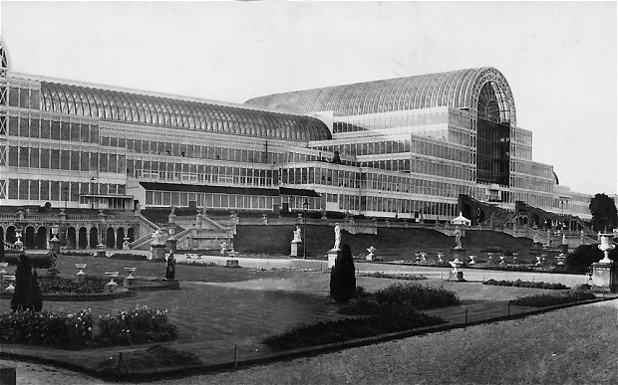

The Crystal Palace,
exhibition hall for the Industrial Revolution, 1851
Designed by Joseph Paxton
Machines
Notes:
Steam Engine
Scottish engineer James Watt, patented a steam engine that produced continuous rotary motion, 1781
Reciprocating piston type steam engines remained the dominant source of power until the early 20th century

Slide 9
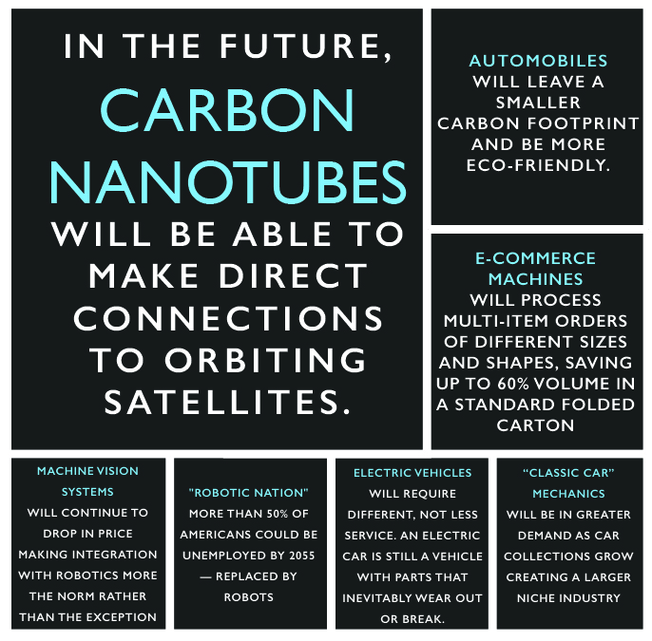
Kevin Murnane
Wall Street Journal
2017
Tim Sykes
Packaging Europe 2017
Eric Loveday
Inside EV’s
2016
Notes:
AR=Academic Publishing Platform

Slide 10

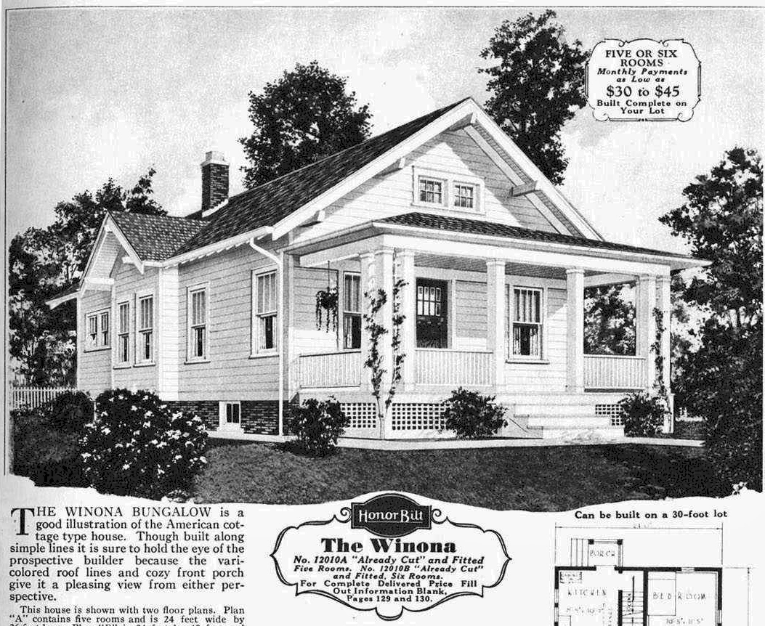
Living
Falling Water or the Kaufmann Residence
designed by architect Frank Lloyd Wright in 1935
rural Pennsylvania
Cantilever
Environment
Form Follows Function
Notes:
The Winona
1930’s home available from SEARS.
Cantilever
Form follows Function—William Ruskin and William Morris
Wright known for working with the surrounding environment/context

Slide 11
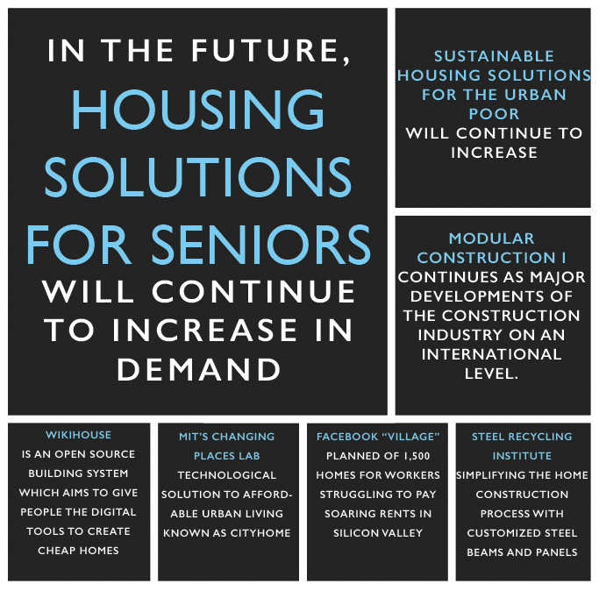
Panasonic
2016
Sini Kotilainen
Built Environment Solutions
2016
Rupert Neate
The Guardian
2017

Slide 12
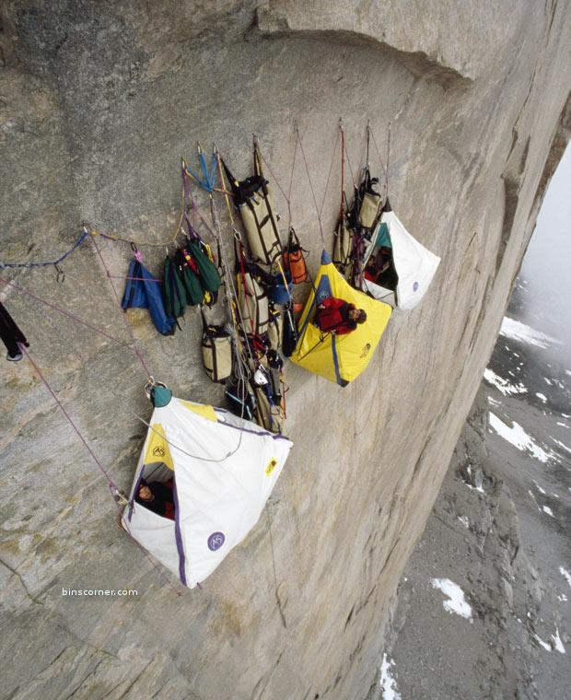
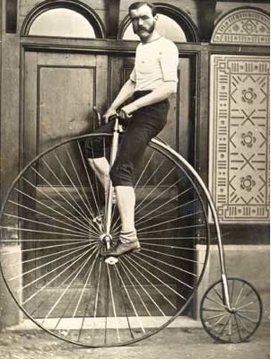
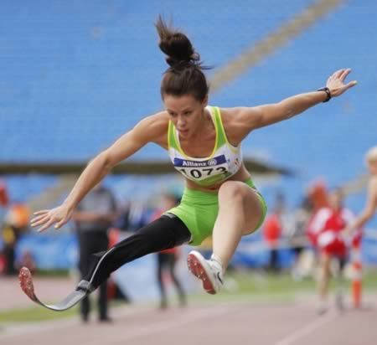

New
Materials
Notes:
Carbon Fiber was just the start
Why did early bicycles have such large front wheels? Simply put—speed. The pedals and cranks were still attached to the front wheel thus, the larger the wheel, the greater the rotation and the greater the distance traveled. The phrase “taking a header” originates with these Pennyfarthings. Falling riders usually landed on their heads. Descending mountain passes on such a contraption would have been an adventure, indeed!

Slide 13
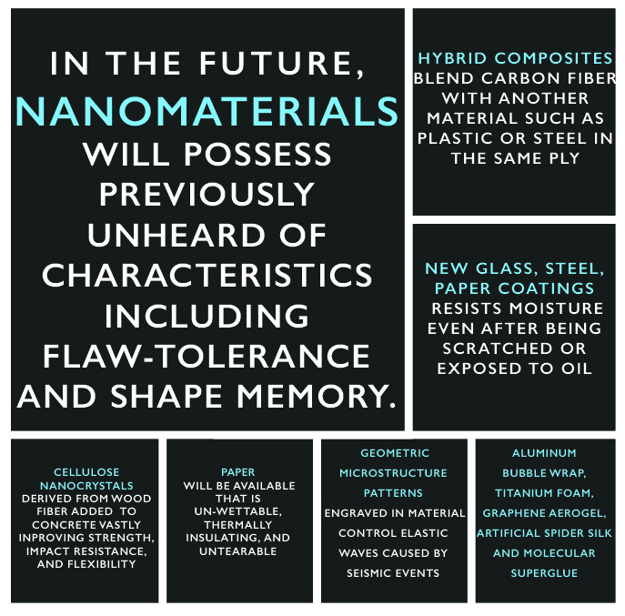
ECO Building Pulse—Hallie Busta, 2015

Slide 14
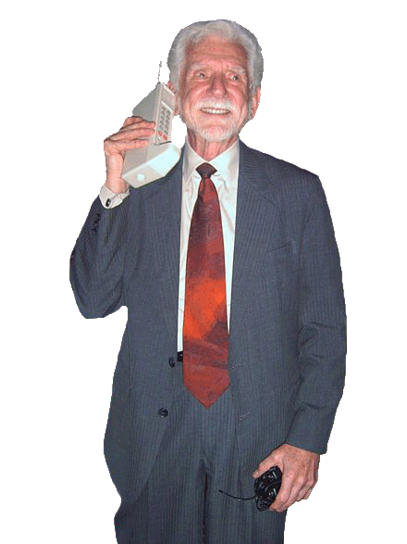
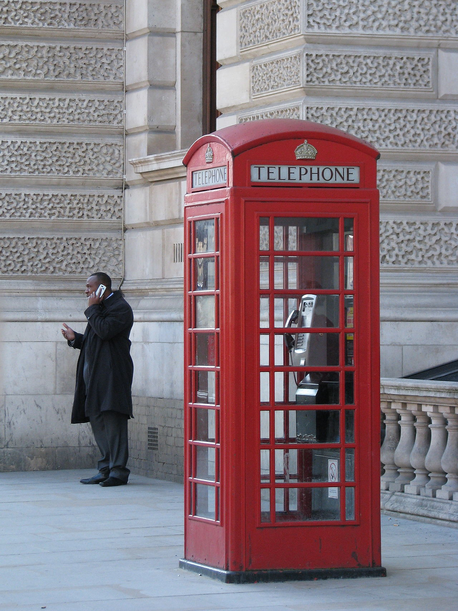


Motorola Mobile Phone Prototype
1973
Inventor Martin Cooper photographed in 2007
Communication
Notes:
Its ”social” media

Slide 15
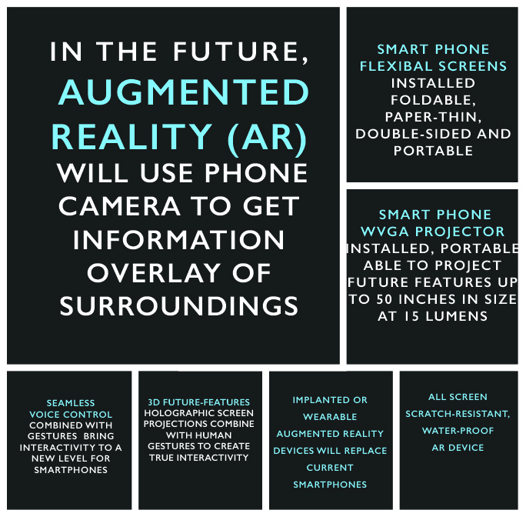
hongkiat
Michael Poh
2017
Daniel B. Kline (TMFDankline)
Wall Street Journal
2017

Slide 16
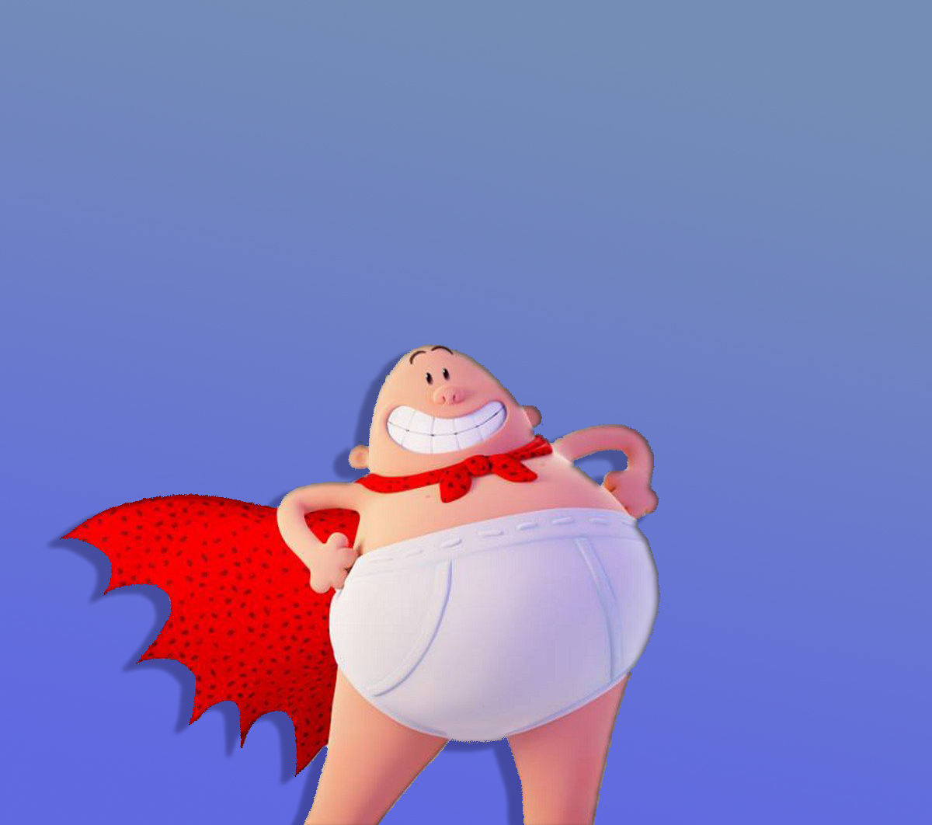
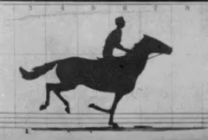
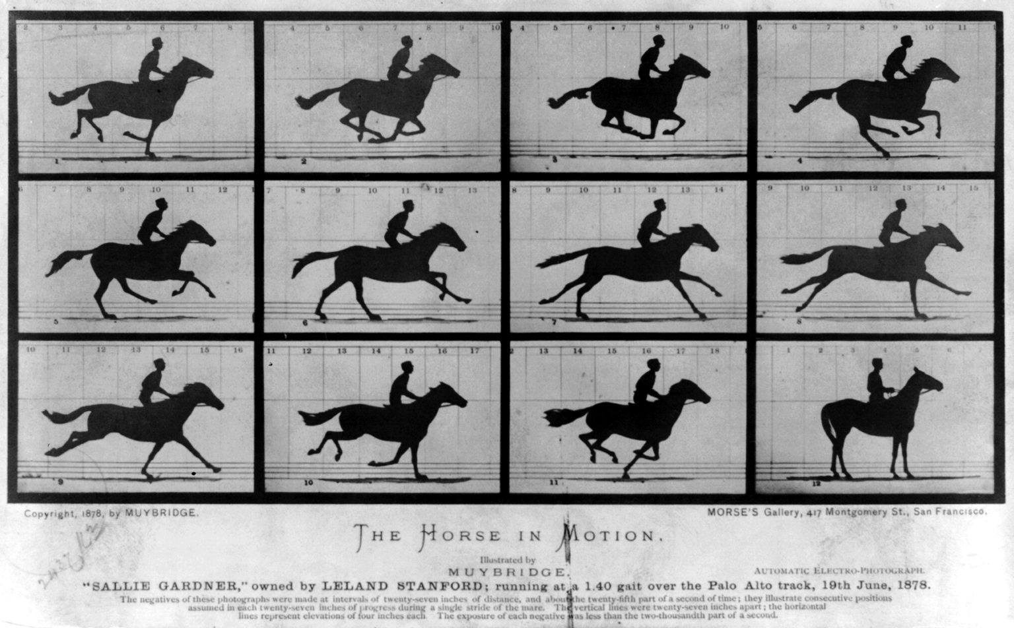
Animation
The Horse in Motion
1878
Eadweard Muybridge

Slide 17
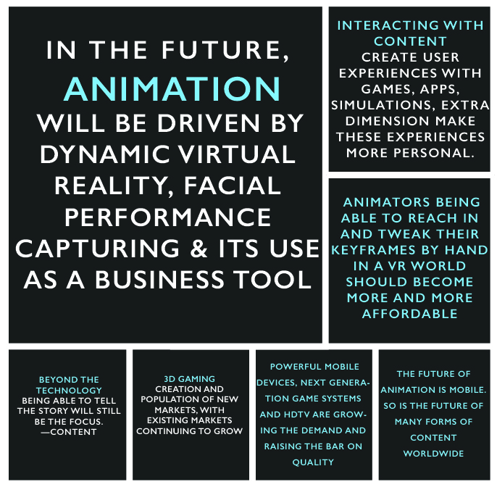
Robin Wilding
Animation career review 2017

Slide 18
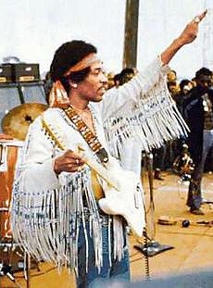
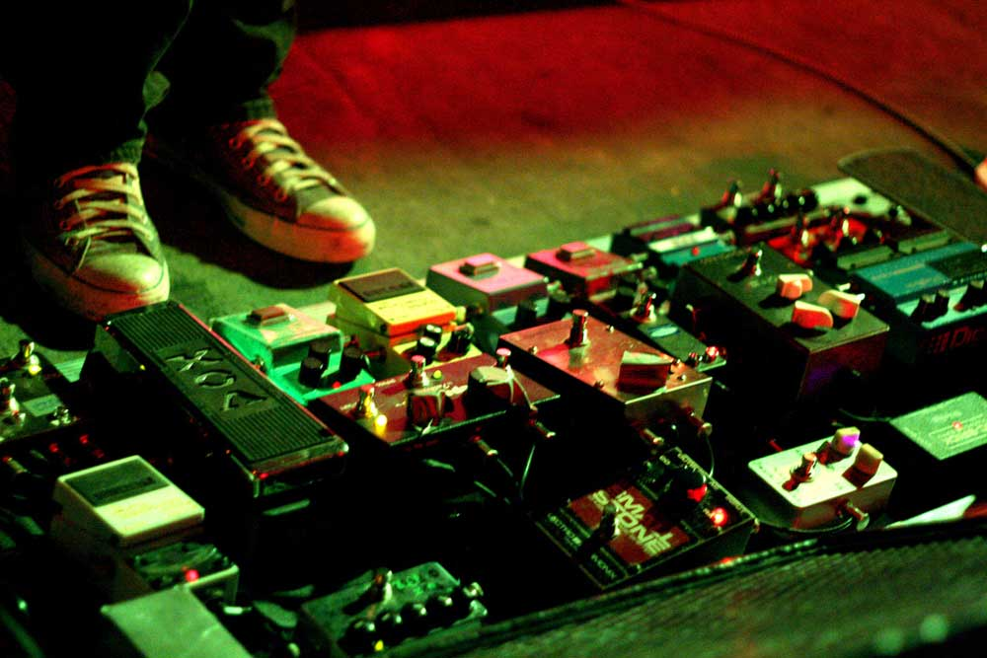
Electronic
Music
Jimi Hendrix
1969
Woodstock Music Festival
Bethel, NY

Slide 19
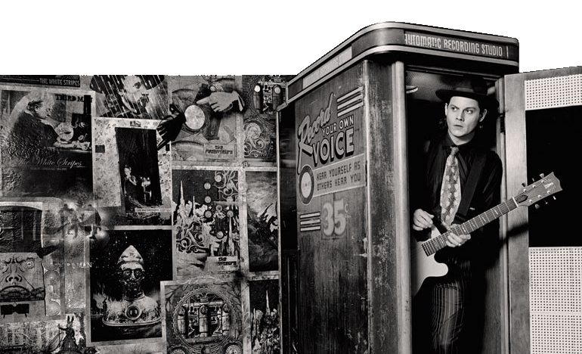
John Naisbitt
first developed the concept of high tech, high touch in his 1982 bestseller Megatrends. He theorized that in a world of technology, people long for personal, human contact.
Jack White
3rd Man Recording Studio The Blue Room and Jack’s Voice-O-Graph
Notes:
Need or renewed interest in the past
Retro styles
Acoustic music
Warm sound

Slide 20
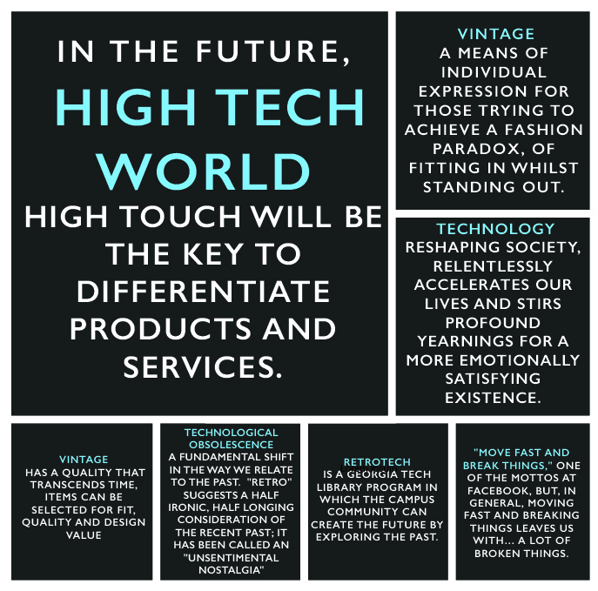
John Walsh
independent
2017
John Naisbitt
High Tech/High Touch
1999
Dan Lyons
Hubspot
2013
RetroTech
Georgia Tech
2017

Slide 21
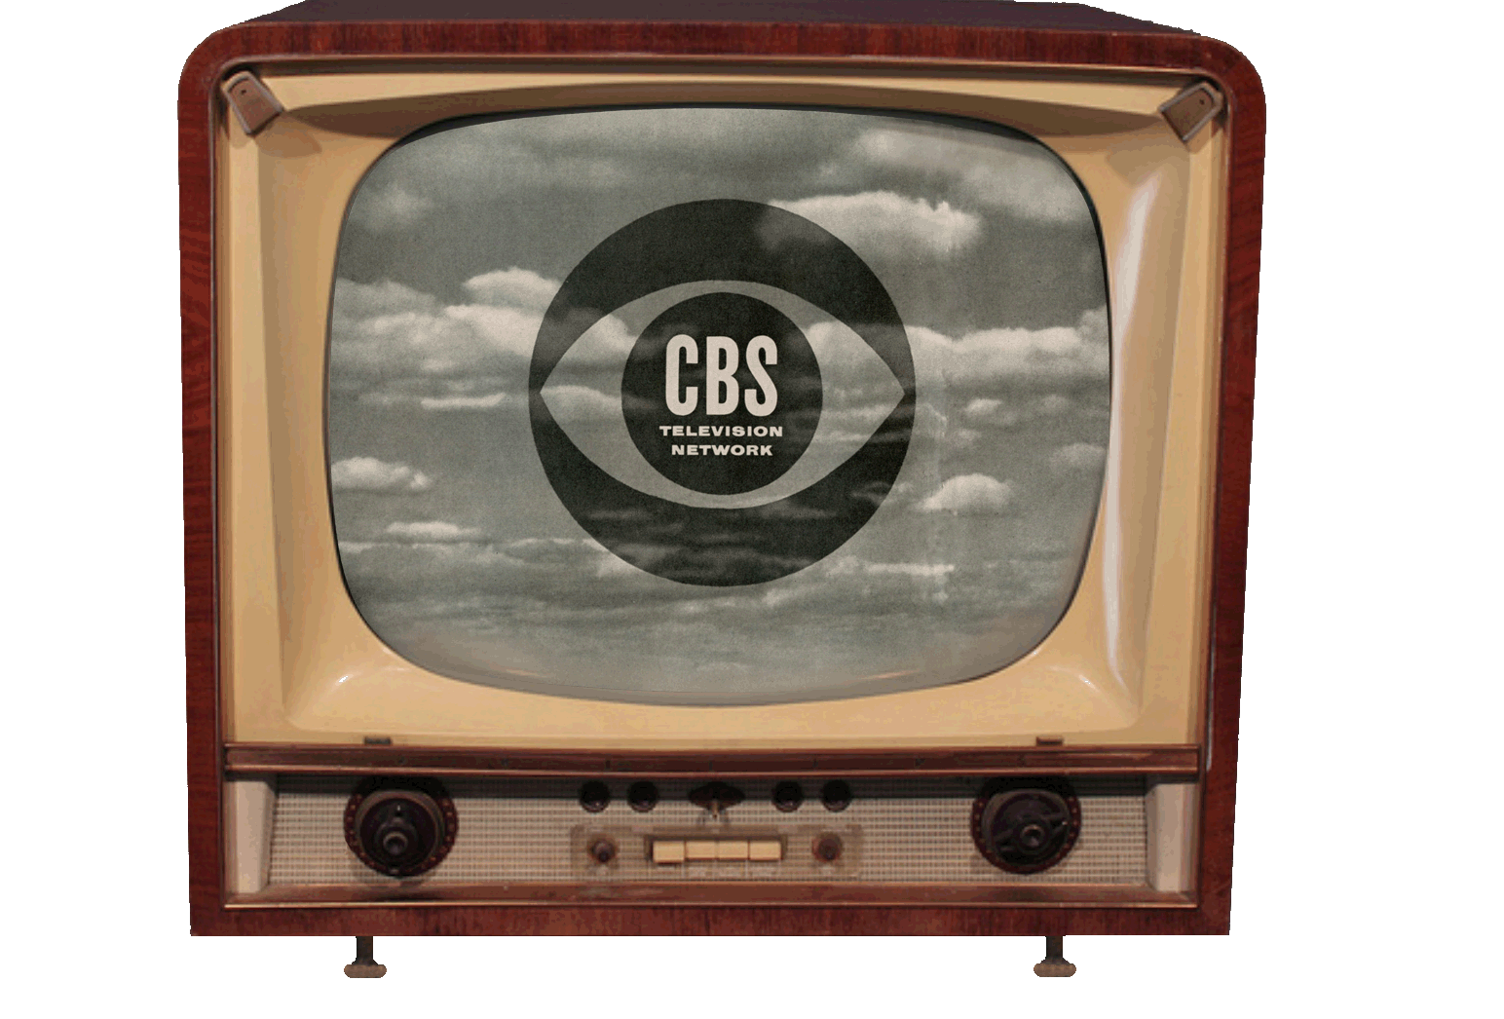
Corporate Identity
CBS “eye” The surrealistic, all seeing logo designed by William Golden,
first introduced on October 20, 1951.
Notes:
The network of the news

Slide 22

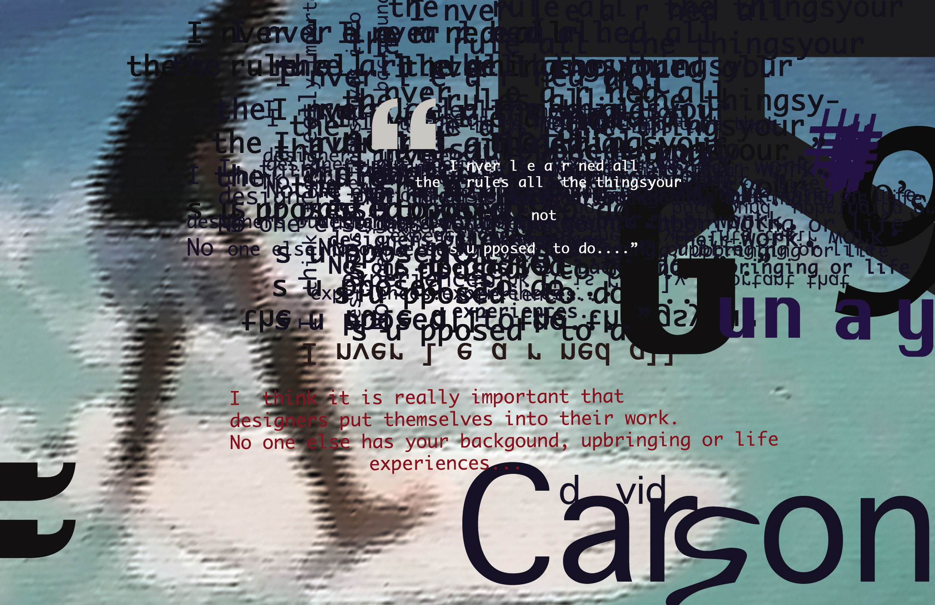
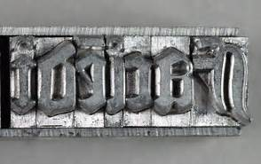
David Carson
best known for his innovative magazine design, and use of experimental so-called “grunge typography” of the 1980”s and early ’90’s.
Johannes Gutenberg
Gutenberg Bible
Incunabula 1450
Print Communication
“Print is Dead”

Slide 23
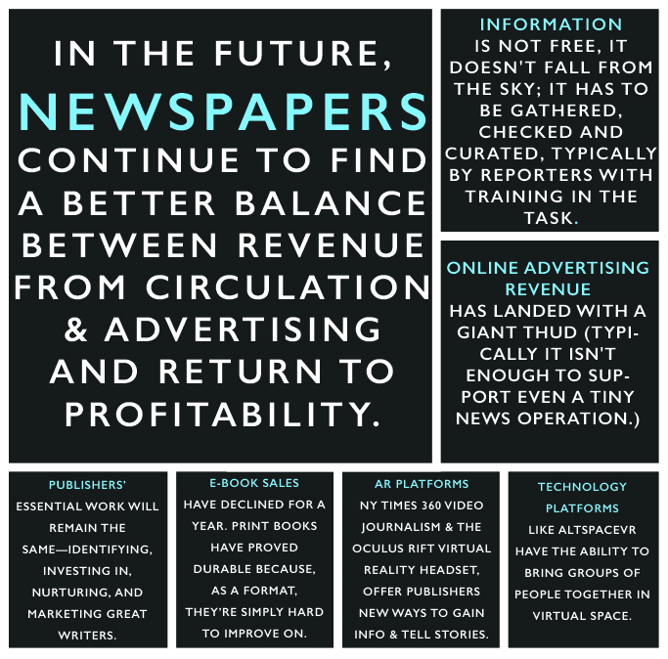
Tony Rogers
AboutNews
2017
Michael Pietsch
Wall Street journal
2017
Calvin Reid |
PW Publishing
2017

Slide 24

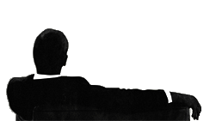
^{• Express the Essence}
^{• Build Emotional Impact}
^{• Deliver the Gift of Delight}
^{• Compel People to Think}
^{• Inspire People to Act}
^{• Create a Moment of Impact}
^{• Tell a Story That is} ^{Compelling}
^{• Begin the Conversation}
Universal Design Brief
MADMEN
NOT

