Slide 1

Funding Arts Education Programs
By Mackenzie Wieland
Senior Seminar • Fall 2020
Notes:
<a href="https://www.vecteezy.com/free-photos/back-to-school">Back To School Stock photos by Vecteezy</a>

Slide 2
Appealing to the Audience
(with Chauncy pro)
Notes:
Active members of the PTA within Title 1 schools
“Susan”
Want what’s best for their children and are not afraid to be outspoken about it

Slide 3
Notes:
COLOR THEORY
Yellow bus, #2 pencil
Red apple
Green grass / fake tanbark grass

Slide 4
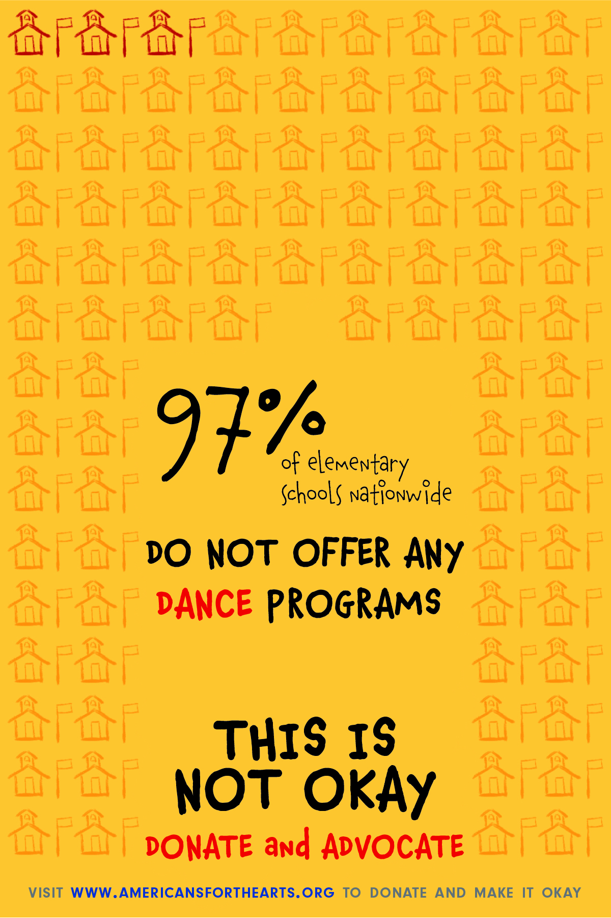
Notes:
89,000 elementary schools nationwide
1 Schoolhouse = 1000 elementary schools

Slide 5
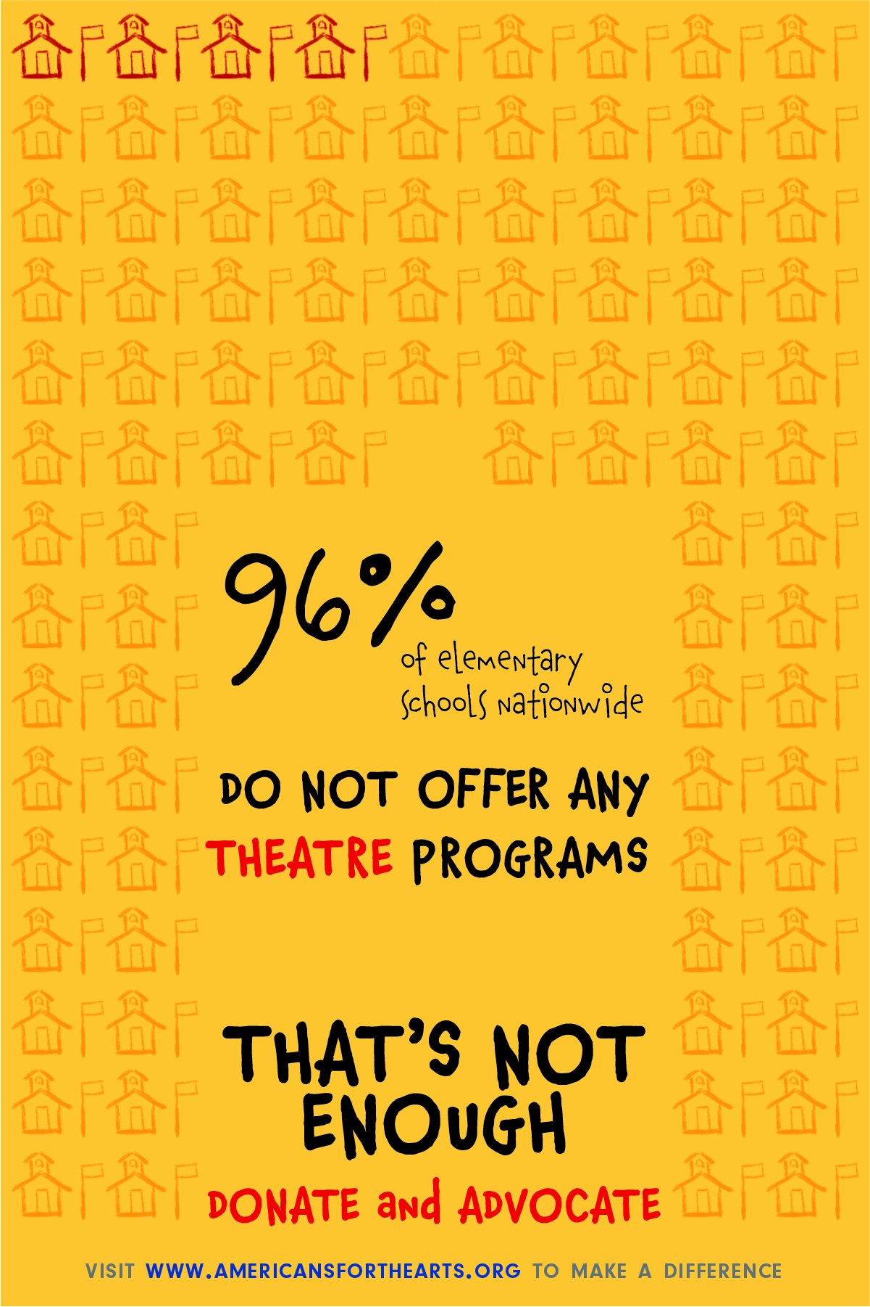

Slide 6
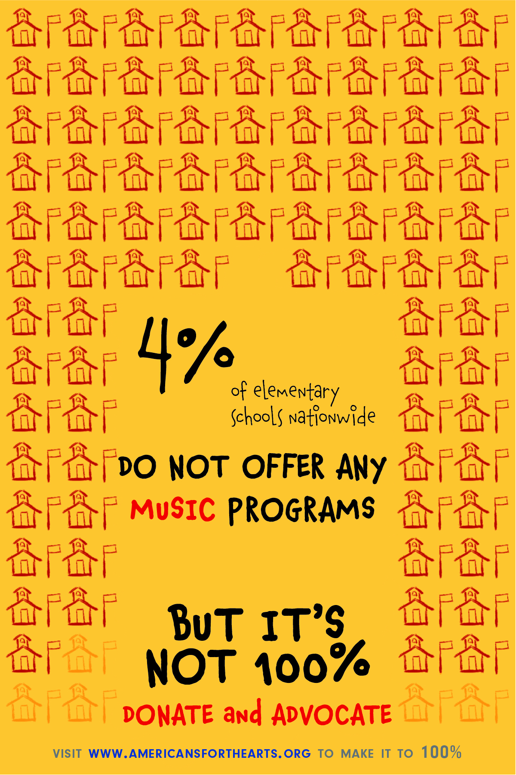

Slide 7
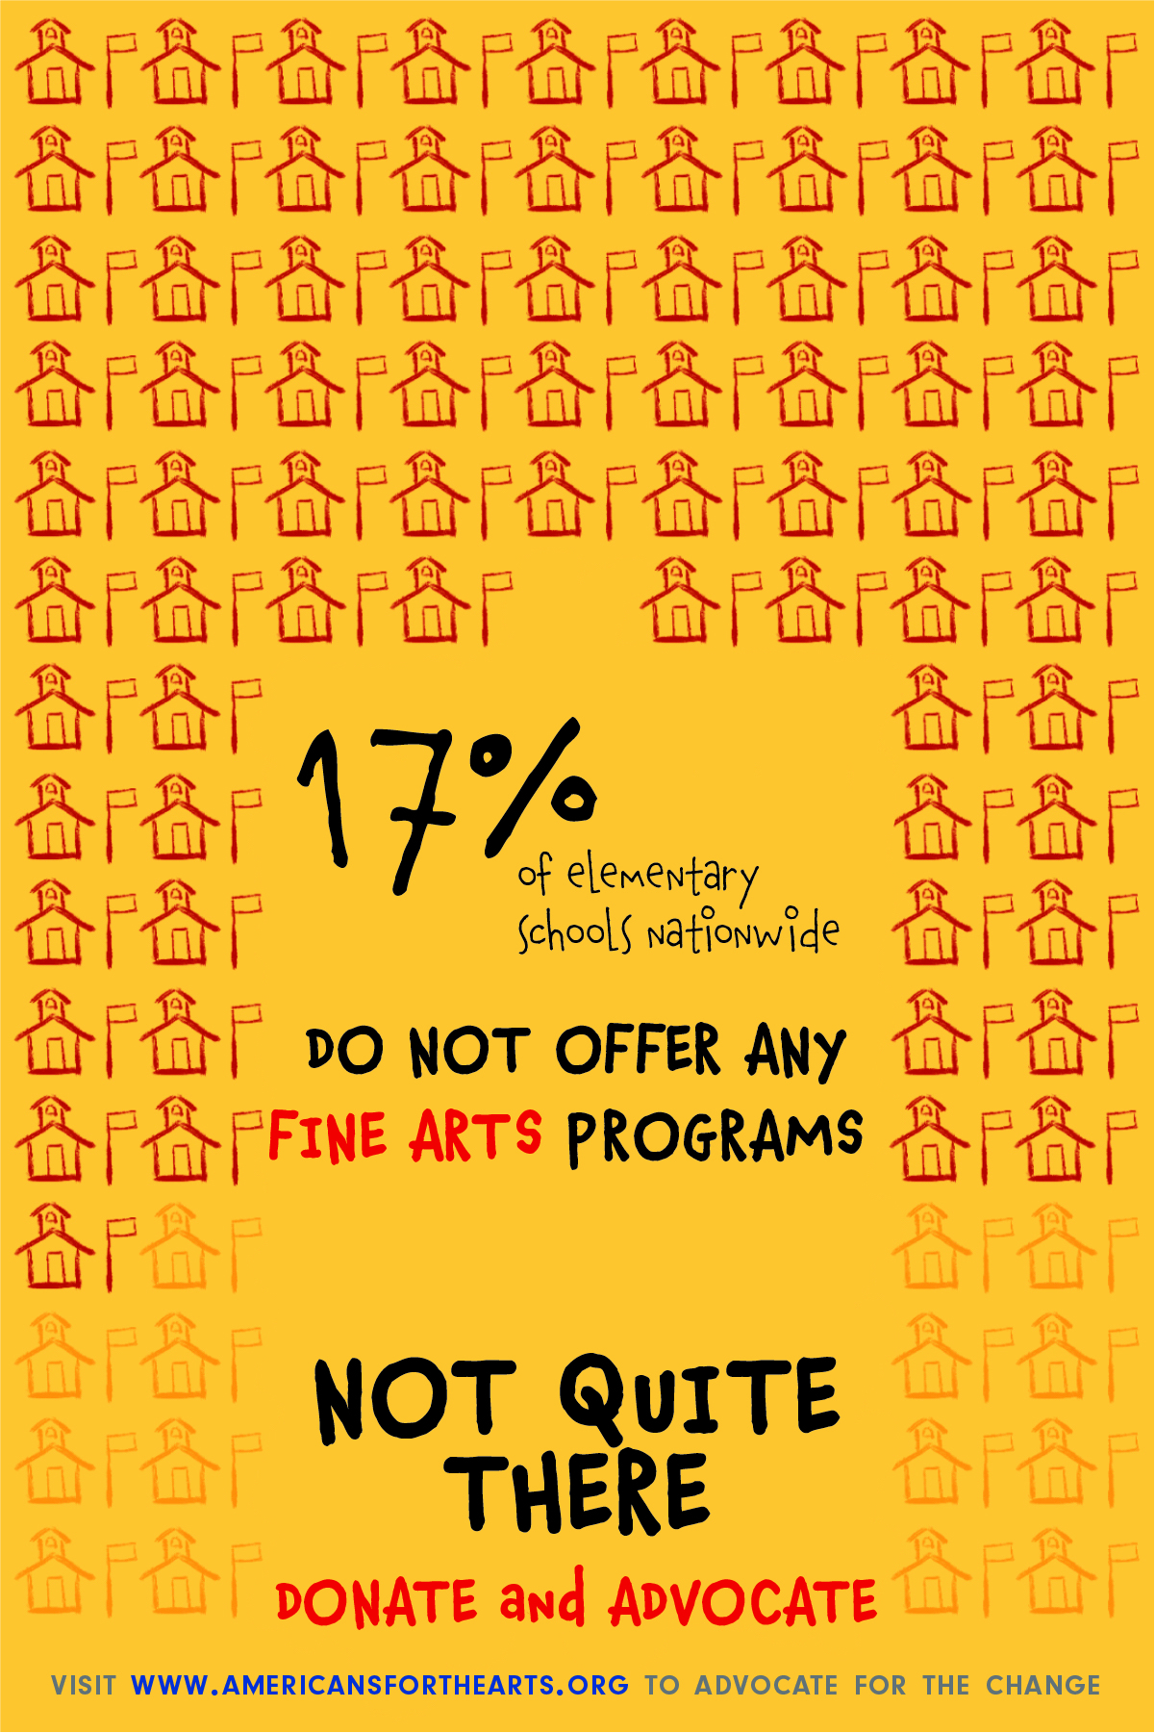

Slide 8


