Slide 1
Frank Lloyd Wright THE BUILDING BEAUTIFUL
“The mission of an architect is to help people understand how to make life more beautiful, the world a better one for living in, and to give reason, rhyme, and meaning to life.”
America’s Architect

Slide 2

Study nature, love nature, stay close to nature. It will never fail you.
FLW was an American architect, interior designer, writer and educator.
He believed in designing structures that were in harmony with humanity and its environment, a philosophy he called organic architecture.
Wright was the pioneer of the Prairie School movement of architecture and he also developed the concept of the Usonian home in Broadacre City, his unique vision for urban planning.
He often designed interior elements for these buildings as well, including furniture and stained glass.
Wright was recognized in 1991 by the American Institute of Architects as “the greatest American architect of all time”.

Slide 3
Form follows function— that has been misunderstood. Form and function should be one, joined in a spiritual union.
Frank Lloyd Wright (1867-1959) is recognized world-wide as one of the most innovative architects of the twentieth century. His work heralded a new thinking in architecture, using innovation in design and engineering made possible by newly developed technology and materials. His creative ability extended far beyond the border of architecture to graphic design, furniture, art glass, textiles, and decorative products for the home.

Slide 4
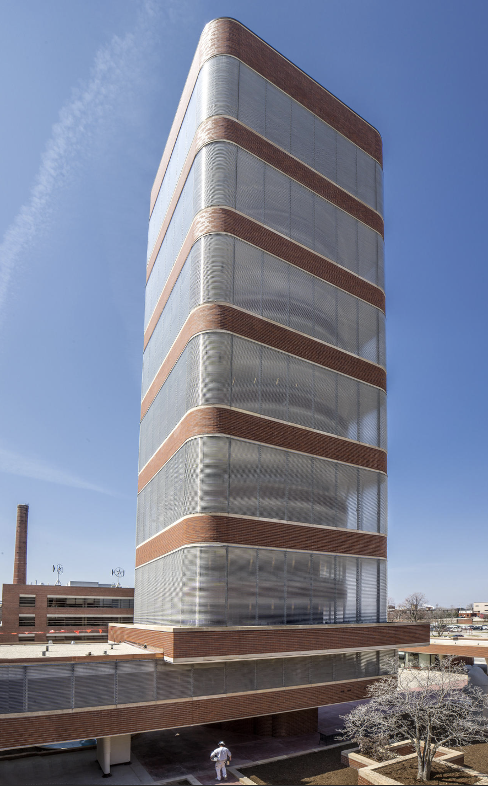
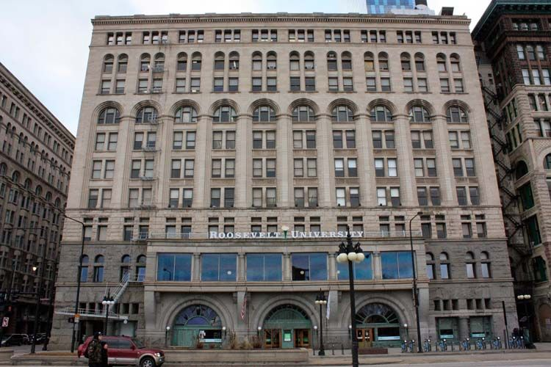
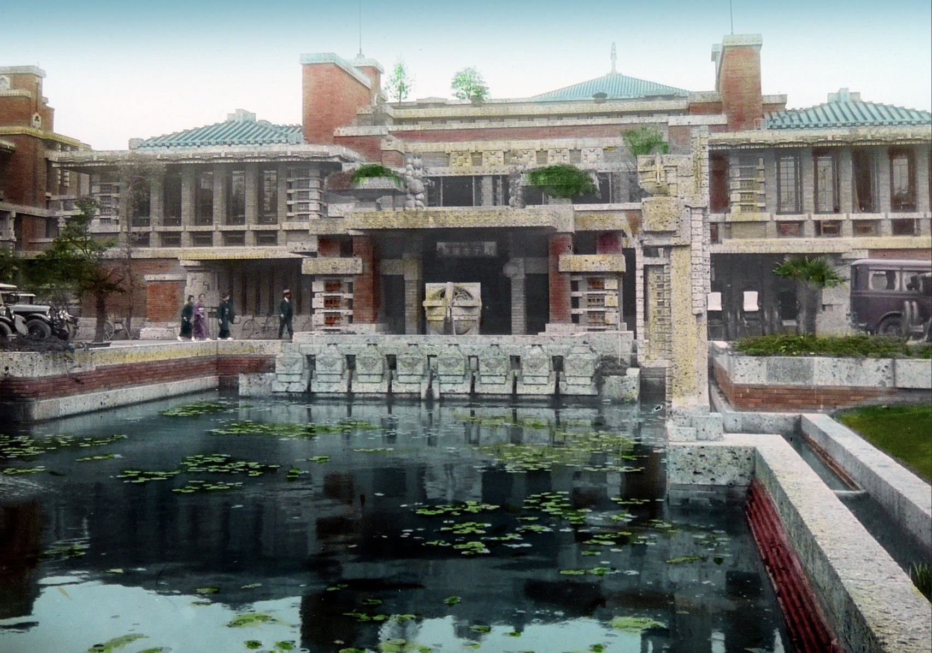
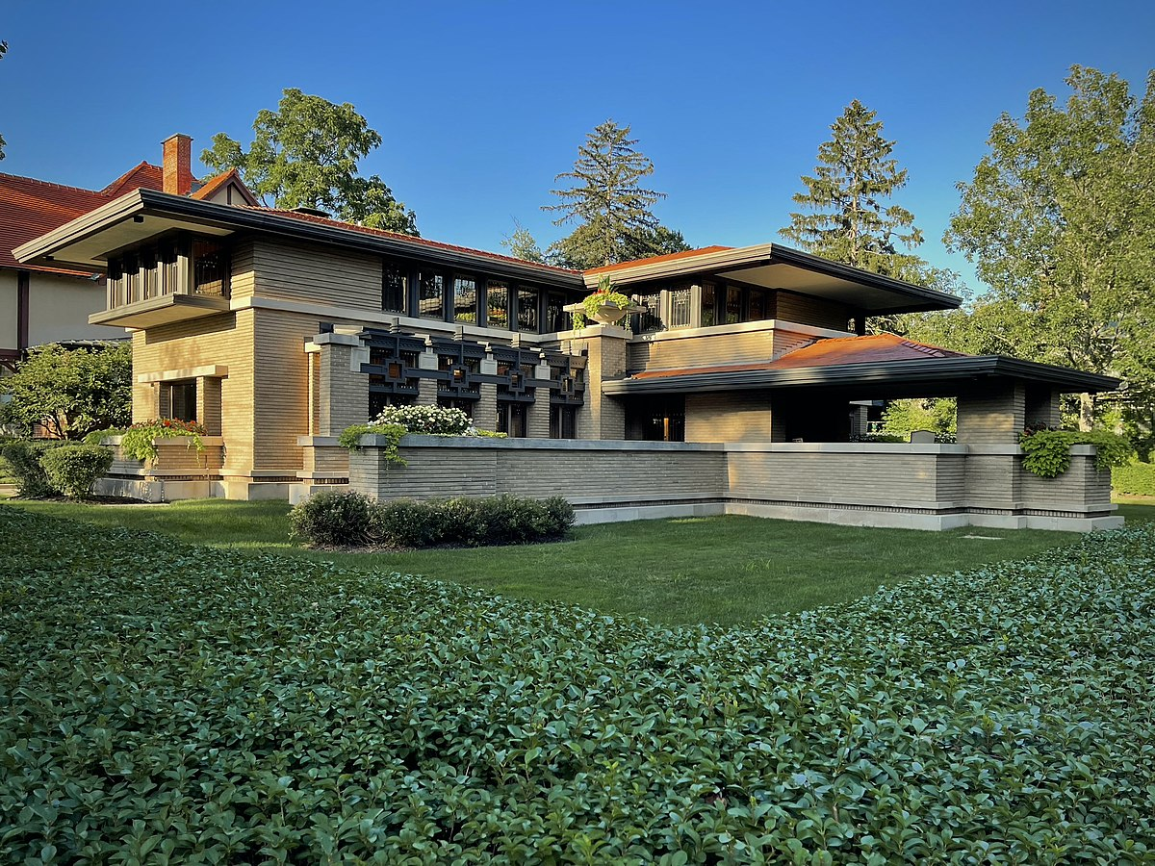
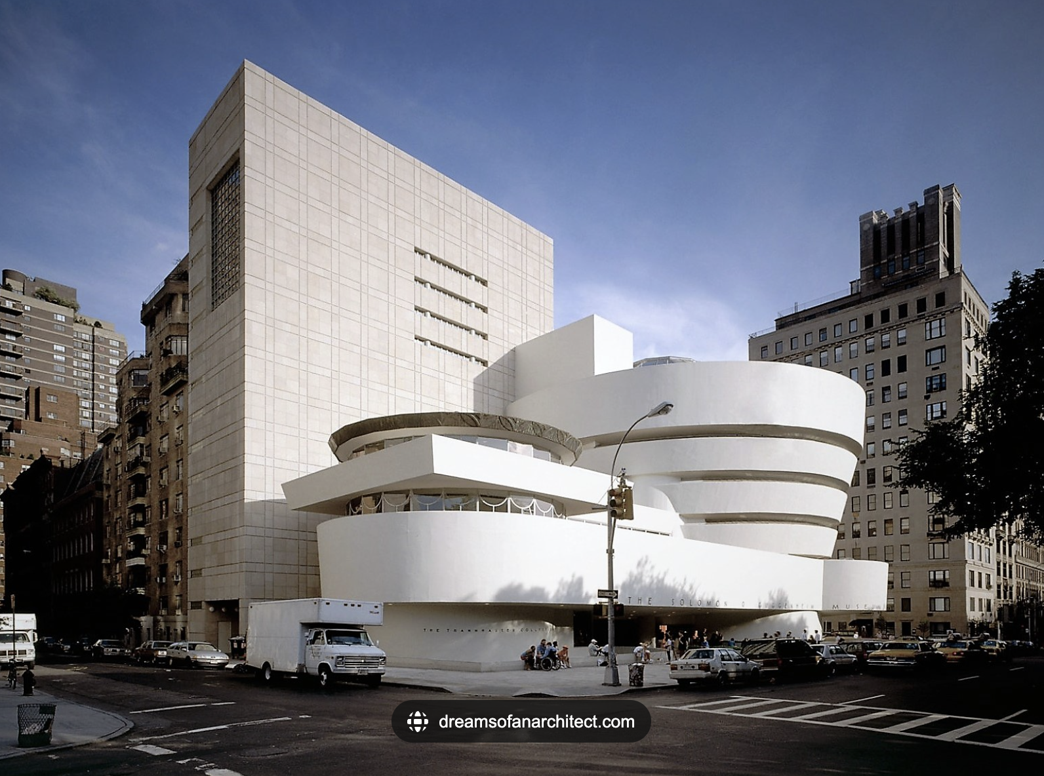
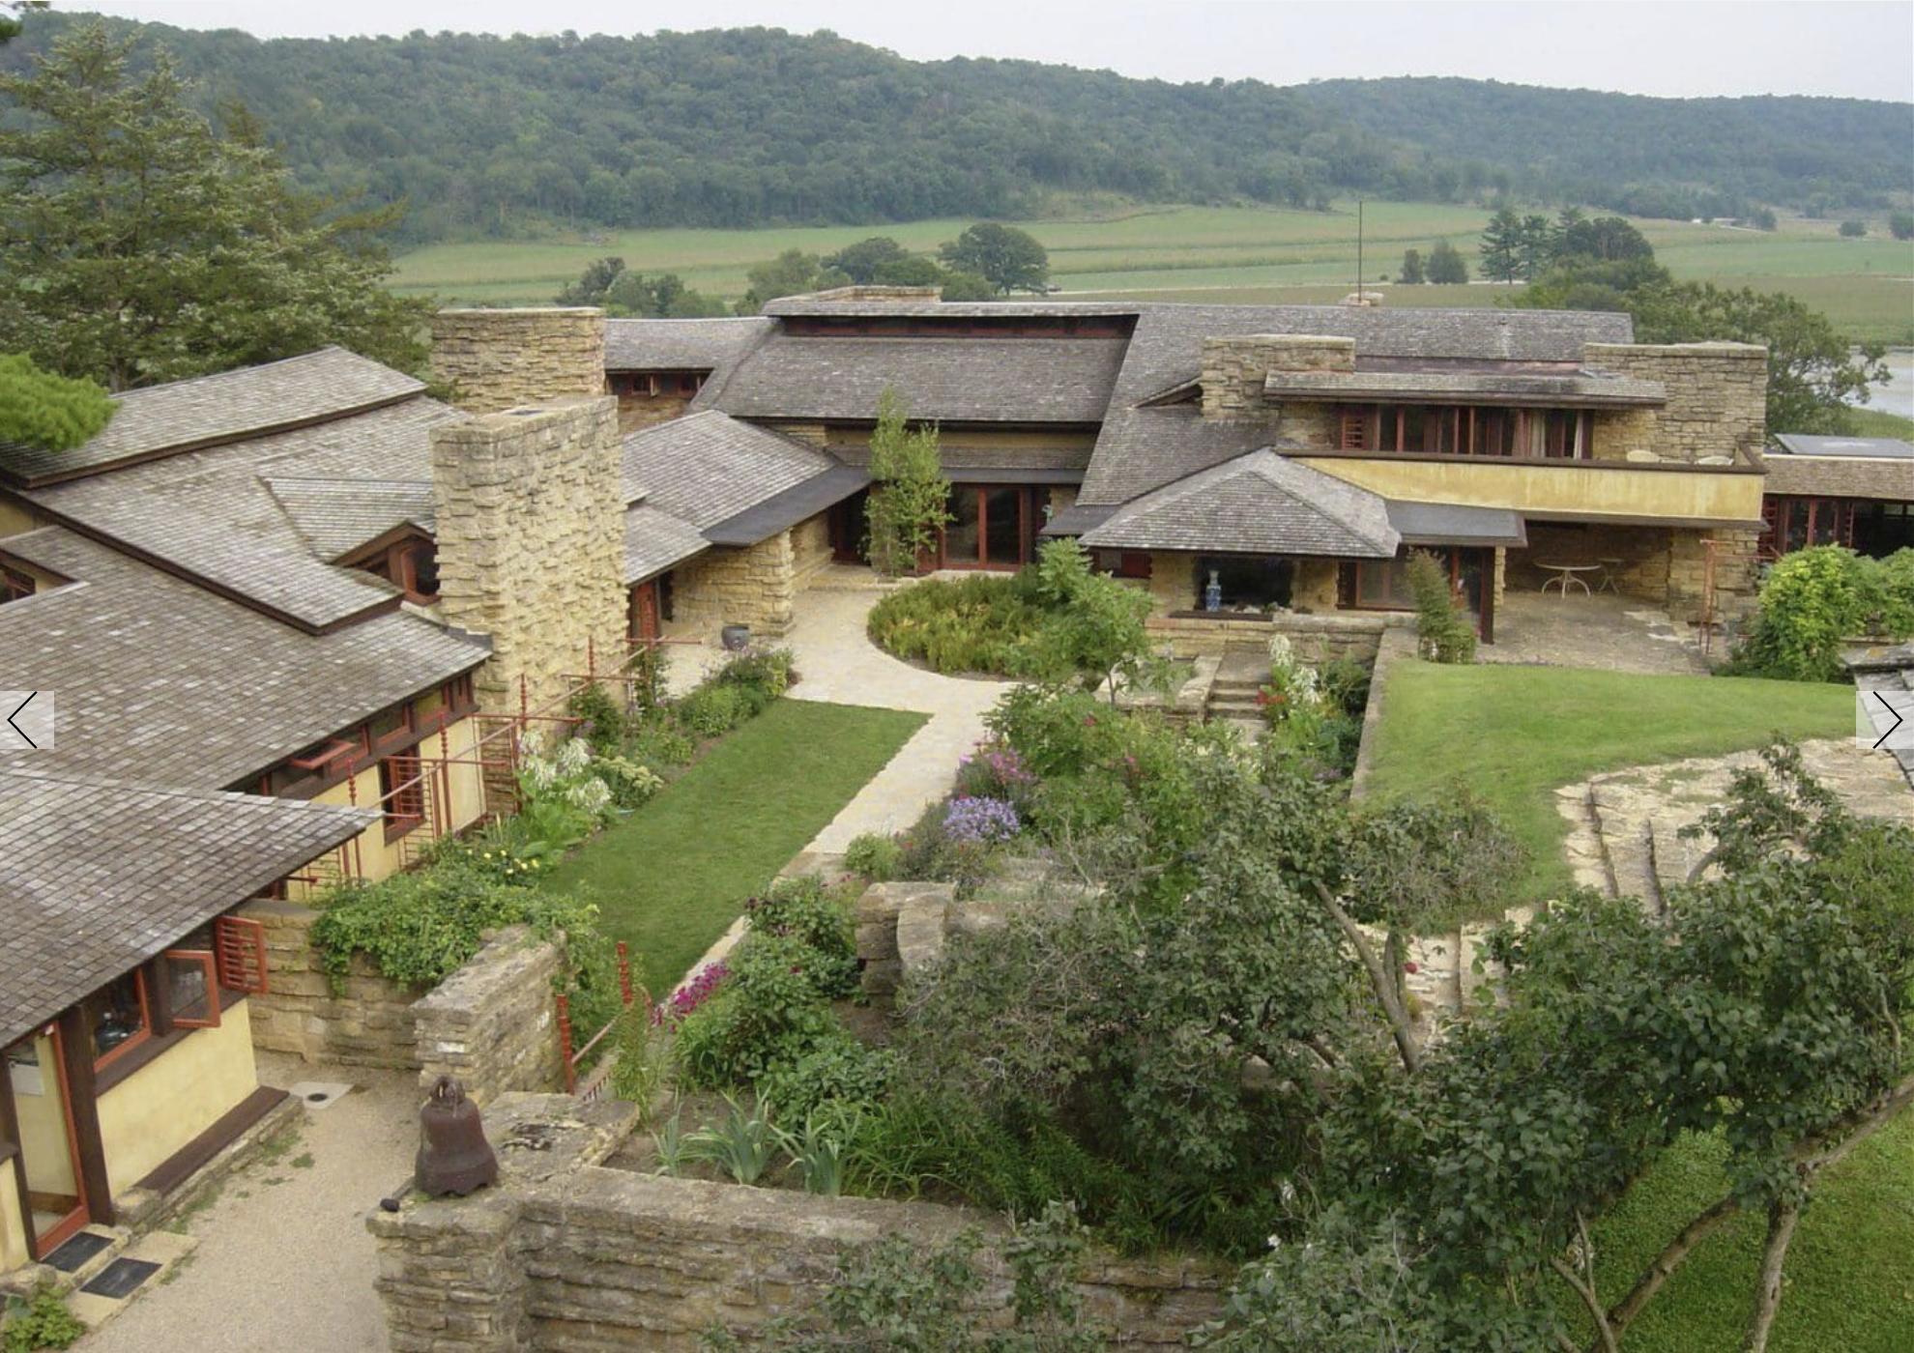
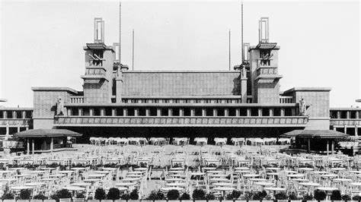
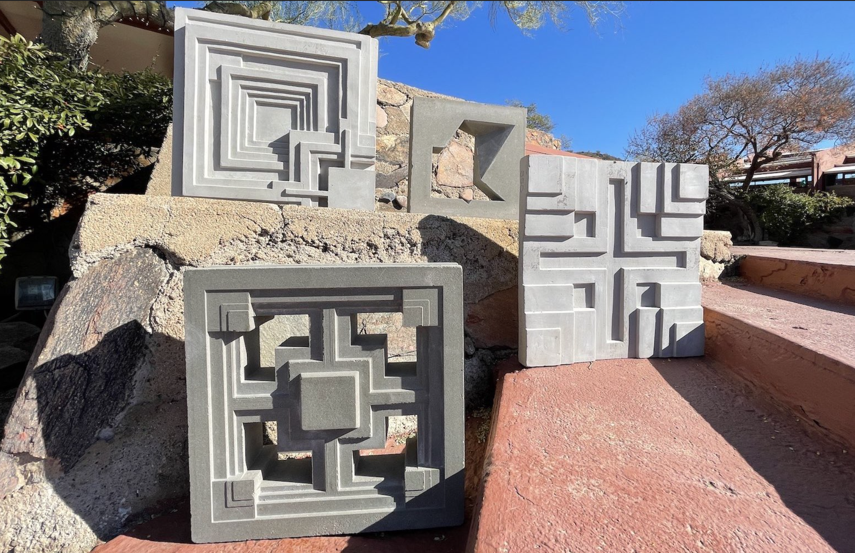
1887—began working for Louis Sullivan (the father of the Modern Skyscraper)
1893—opened his own office and began setting the standards for the Prairie Style characterized by low-pitched roofs, deep overhangs, no attics or basements, and long rows of casement windows that further emphasized the horizontal prairie theme.
1911—began construction of Taliesin in Spring Green, Wisconsin
1913—Midway Gardens in Chicago
1916—new Imperial Hotel Tokyo, Japan
1923–1924—four textile block houses (Millard, Storer, Freeman and Ennis in LA).
1943–1959 Solomon Guggenheim Museum in NYC
1945–55—SC Johnson Research Tower Unitarian Meeting House in Racine, WI
HIGHLIGHTS

Slide 5
Prairie Style
Wright’s work from 1899 to 1910 belongs to what became known as the “Prairie Style.” With the “Prairie house”— a long, low, open plan structure that eschewed the typical high, straight-sided box in order to emphasize the horizontal line of the prairie and domesticity— Wright established the first truly American architecture. In a Prairie house, “the essential nature of the box could be eliminated,” Wright explained.
Interior walls were minimized to emphasize openness and community. “The relationship of inhabitants to the outside became more intimate; landscape and building became one, more harmonious; and instead of a separate thing set up independently of landscape and site, the building with landscape and site became inevitably one.”

Slide 6
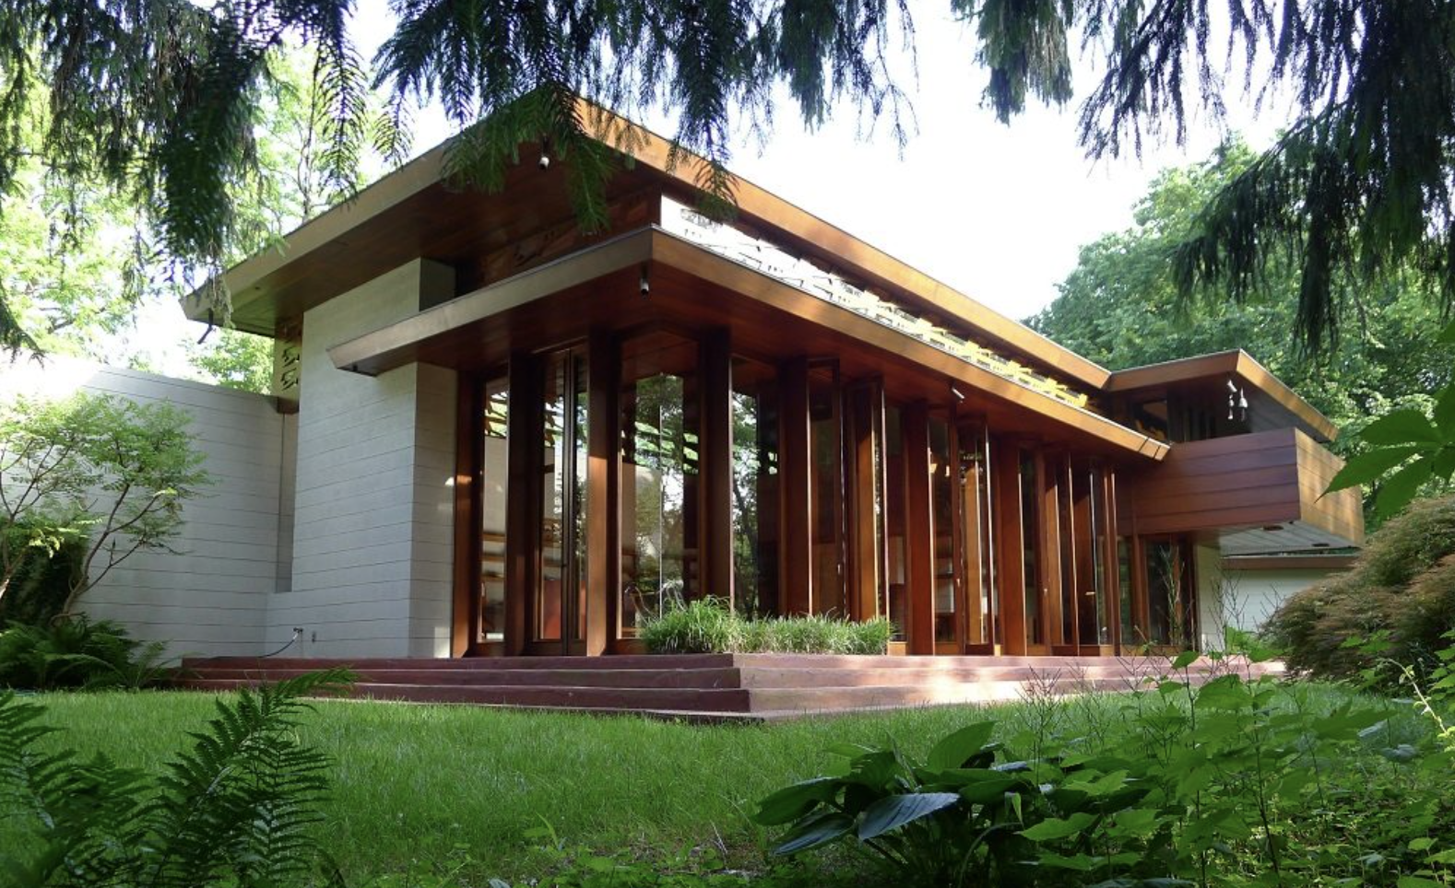
Usonian
Responding to the financial crisis of 1929 and ensuing Great Depression that gripped the United States and the rest of the world, Wright began working on affordable housing, which developed into the Usonian house. Wright’s Usonians were a simplified approach to residential construction that reflected both economic realities and changing social trends. In the Usonian houses, Wright was offering a simplified, but beautiful environment for living that Americans could both afford and enjoy. Wright would continue to design Usonian houses for the rest of career, with variations reflecting the diverse client budgets.

Slide 7
Philosophy
Design for Democracy
Wright always aspired to provide his client with environments that were not only functional but also “eloquent and humane.” Perhaps uniquely among the great architects, Wright pursued an architecture for everyman rather than every man for one architecture through the careful use of standardization to achieve accessible tailoring options to for his clients.
Integrity and Connection
Believing that architecture could be genuinely transformative, Wright devoted his life to creating a total aesthetic that would enhance society’s well being. “Above all integrity,” he would say: “buildings like people must first be sincere, must be true.” Architecture was not just about buildings, but about nourishing the lives of those within them.
Nature’s Principles and Structures
For Wright, a truly organic building developed from within outwards and was thus in harmony with its time, place, and inhabitants. “In organic architecture then, it is quite impossible to consider the building as one thing, its furnishings another and its setting and environment still another,” he concluded. “The spirit in which these buildings are conceived sees all these together at work as one thing.” To that end, Wright designed furniture, rugs, fabrics, art glass, lighting, dinnerware, and graphic arts.

Slide 8

“Color was very important to conveying Frank Lloyd Wright's aesthetic of organic architecture as a unified whole. He drew from two sources in determining his palette for a given project: the nature of the site and the nature of the building materials. In the early projects, particularly the Prairie houses that were constructed of brick and stucco, autumnal colors predominate: warm shades of red, gold, brown and yellow-green. These restful yet intense colors were accented by a palette of related hues and created a harmonious, unified and serene environment for the client. At Fallingwater, Wright employed both a limited palette of color and a limited number of materials in his desire to create an organic and integrated whole.”—Lynda Waggoner, Vice President & Director of Fallingwater
FLW Color Palette

Slide 9
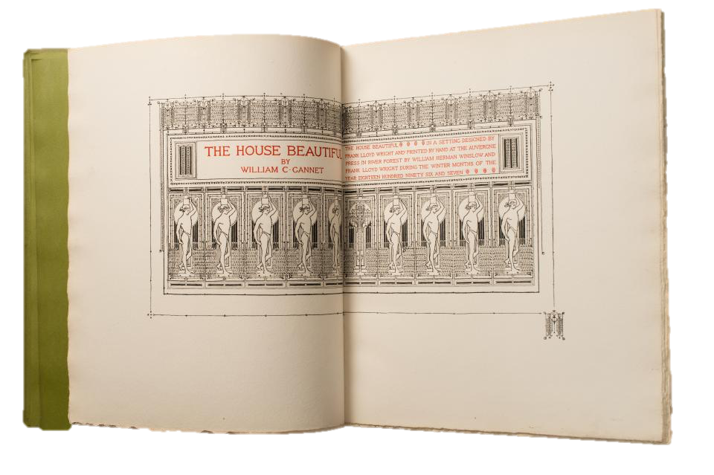

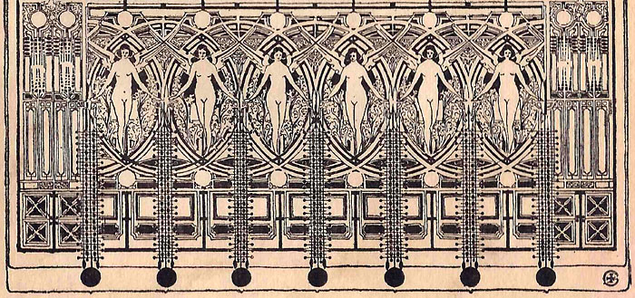
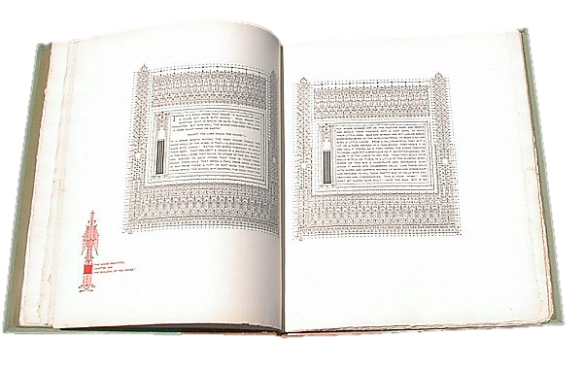
The House Beautiful was first produced 2–3 years before Wright’s version. FLW’s was printed in a limited edition of 90 by The Auvergne Press, River Forest in 1896–98. The Auvergne Press was established by two of Wright's clients, William H. Winslow and Chauncey L. Williams in the stable designed for Winslow. Printed by hand by Winslow and Wright.
The House Beautiful—book design

Slide 10

Adapted from a design by Frank Lloyd Wright. Designers: Frank Lloyd Wright, David Siegel, Carol Toriumi-Lawrence and Carima El-Behairy.
P22-Eaglefeather typeface

Slide 11
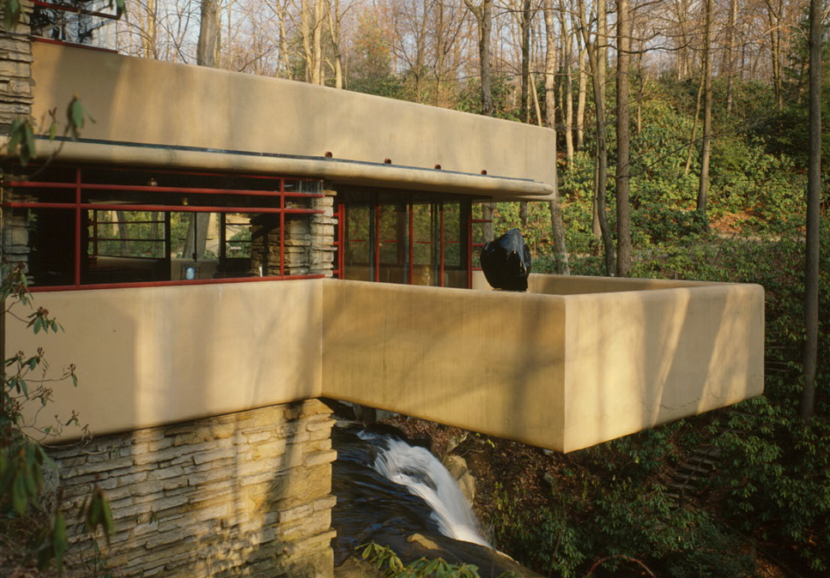
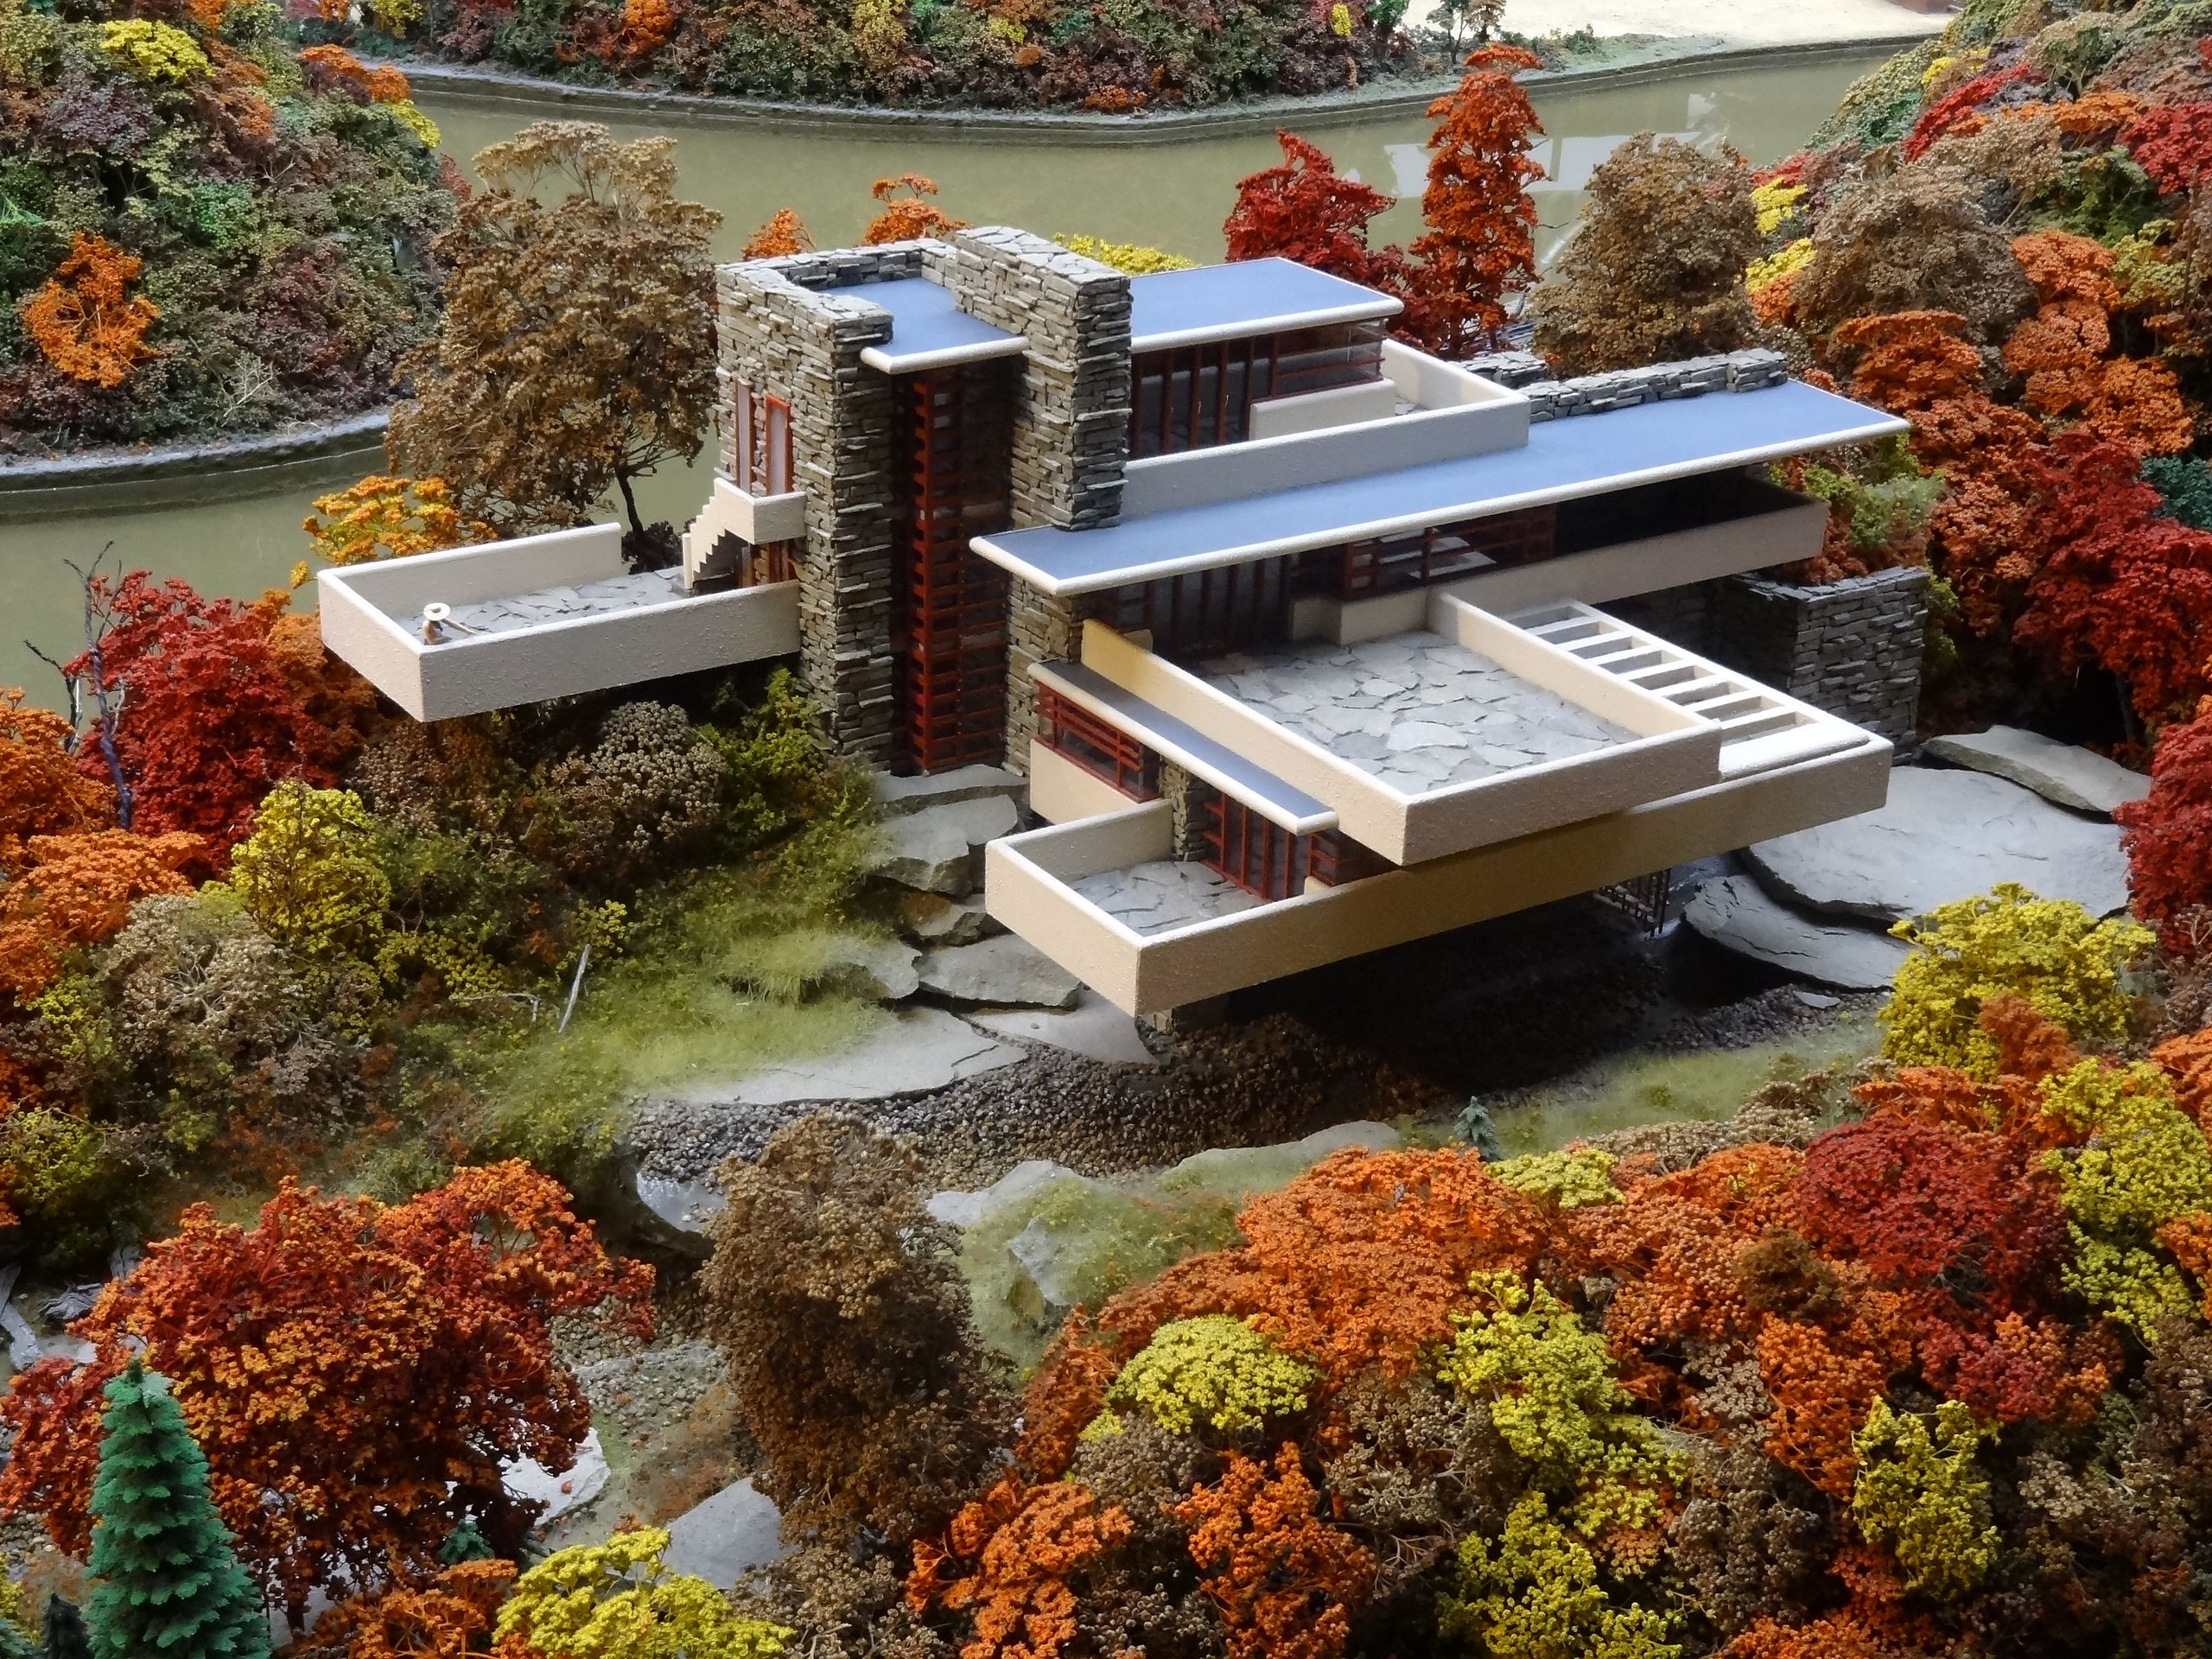
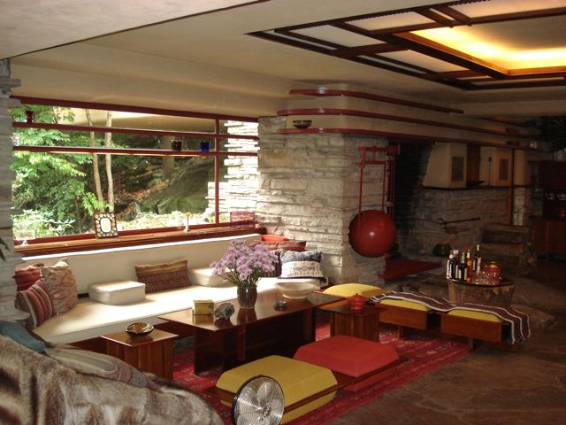
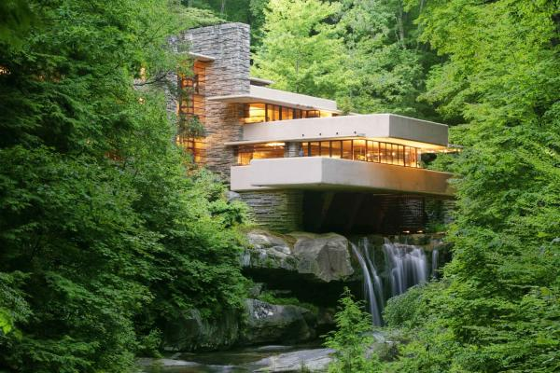
Falling Water, or Kaufmann Residence, Pennsylvania, 1935
The home was built partly over a waterfall on Bear Run in the Mill Run section of Stewart Township, Fayette County, Pennsylvania

Slide 12
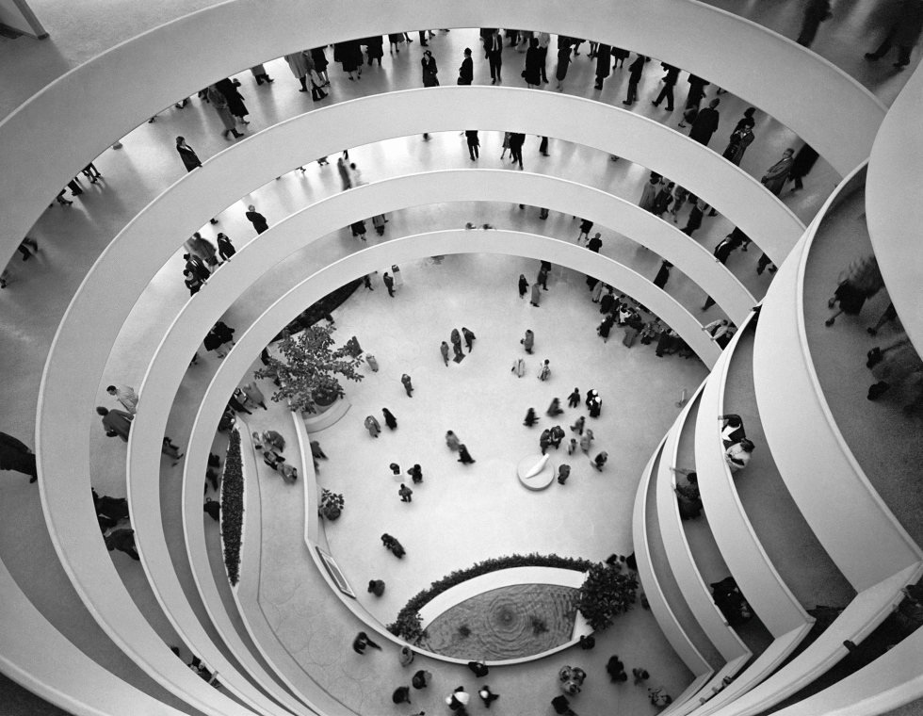
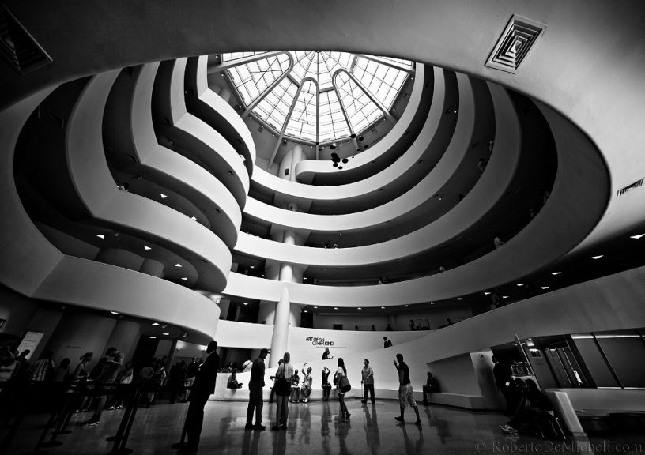
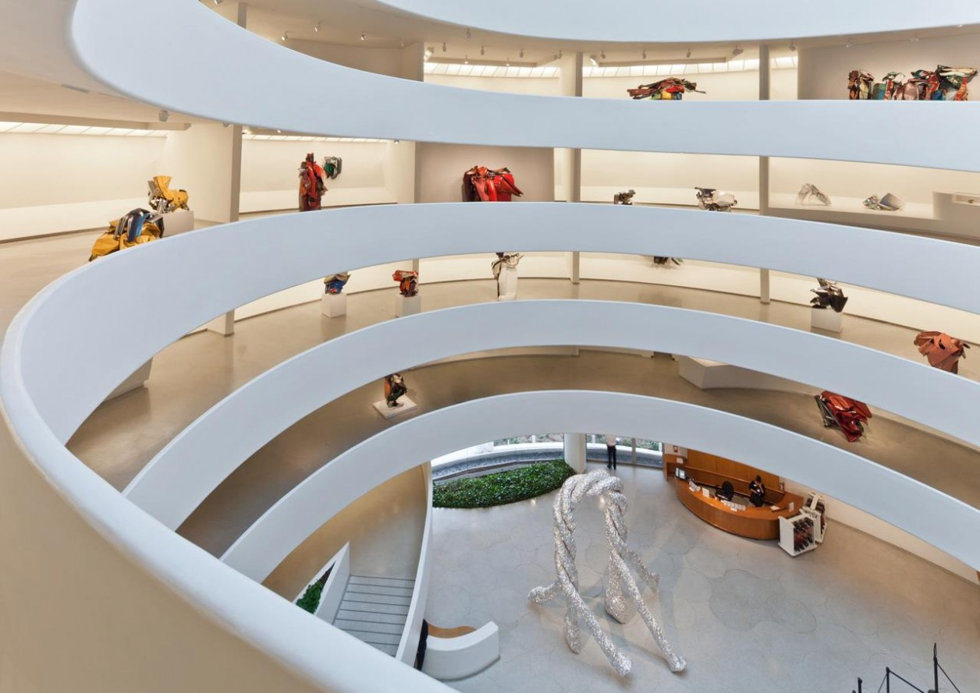
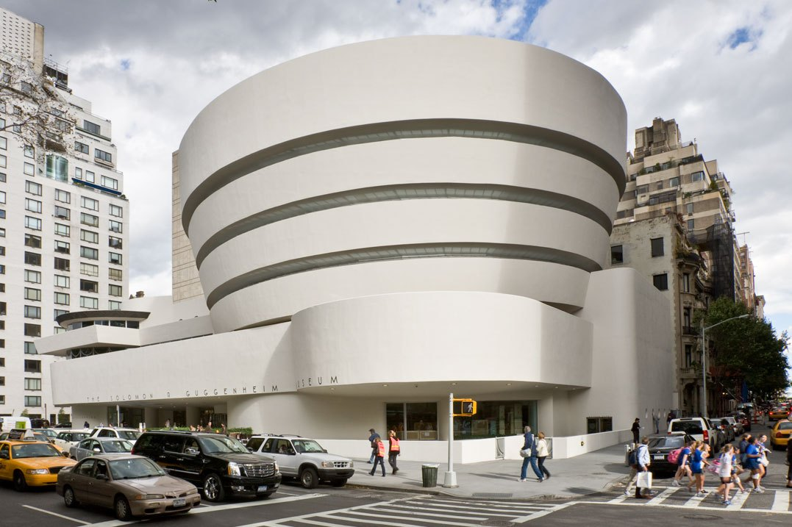
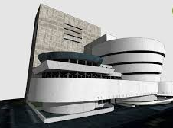
Solomon Guggenheim Museum, Central Park East, NYC, 1959
The cylindrical building, wider at the top than the bottom, was conceived as a “temple of the spirit”. Its unique ramp gallery extends up from ground level in a long, continuous spiral along the outer edges of the building to end just under the ceiling skylight.

Slide 13
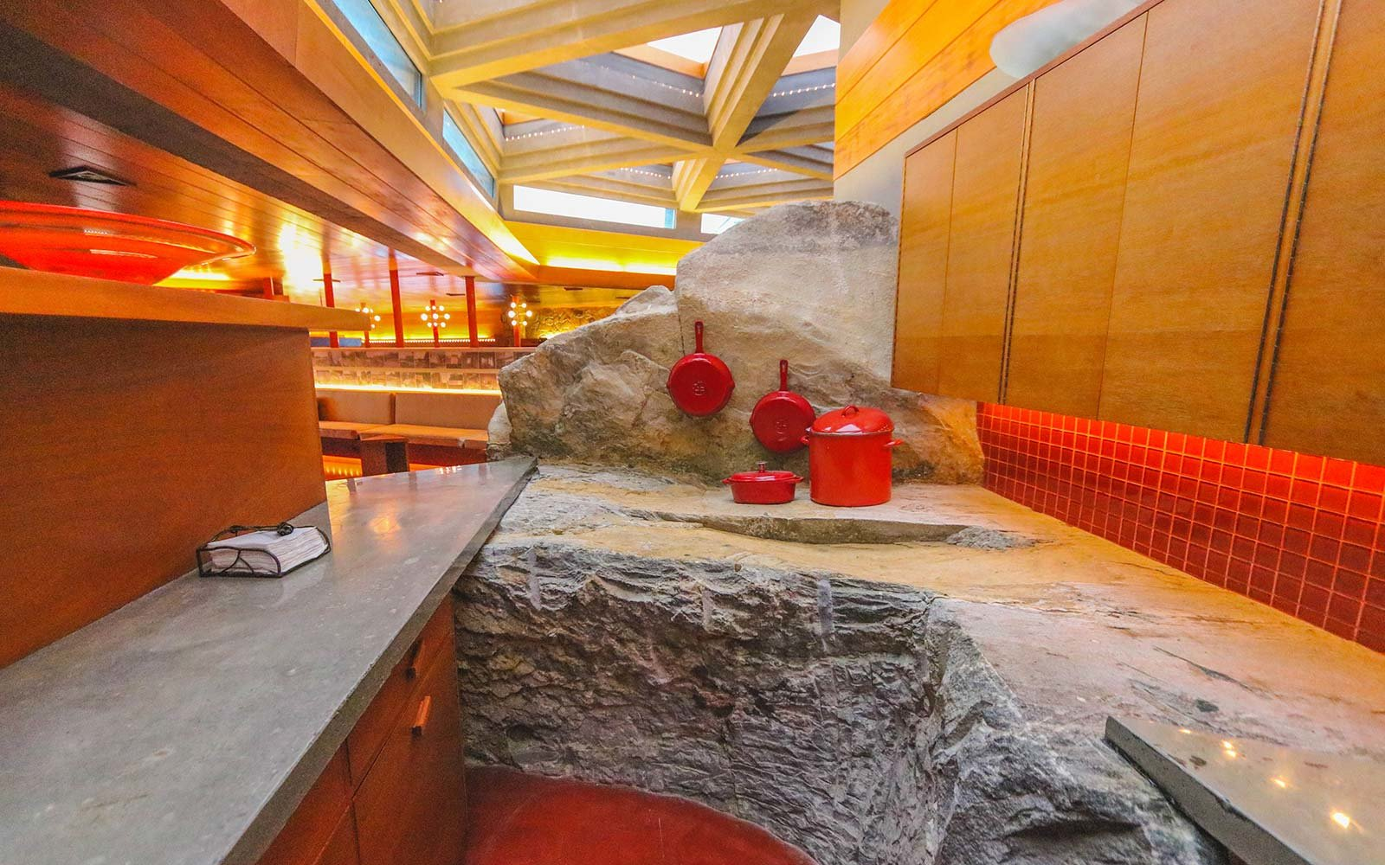
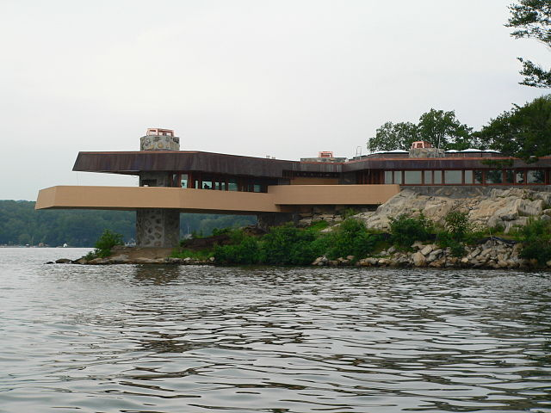
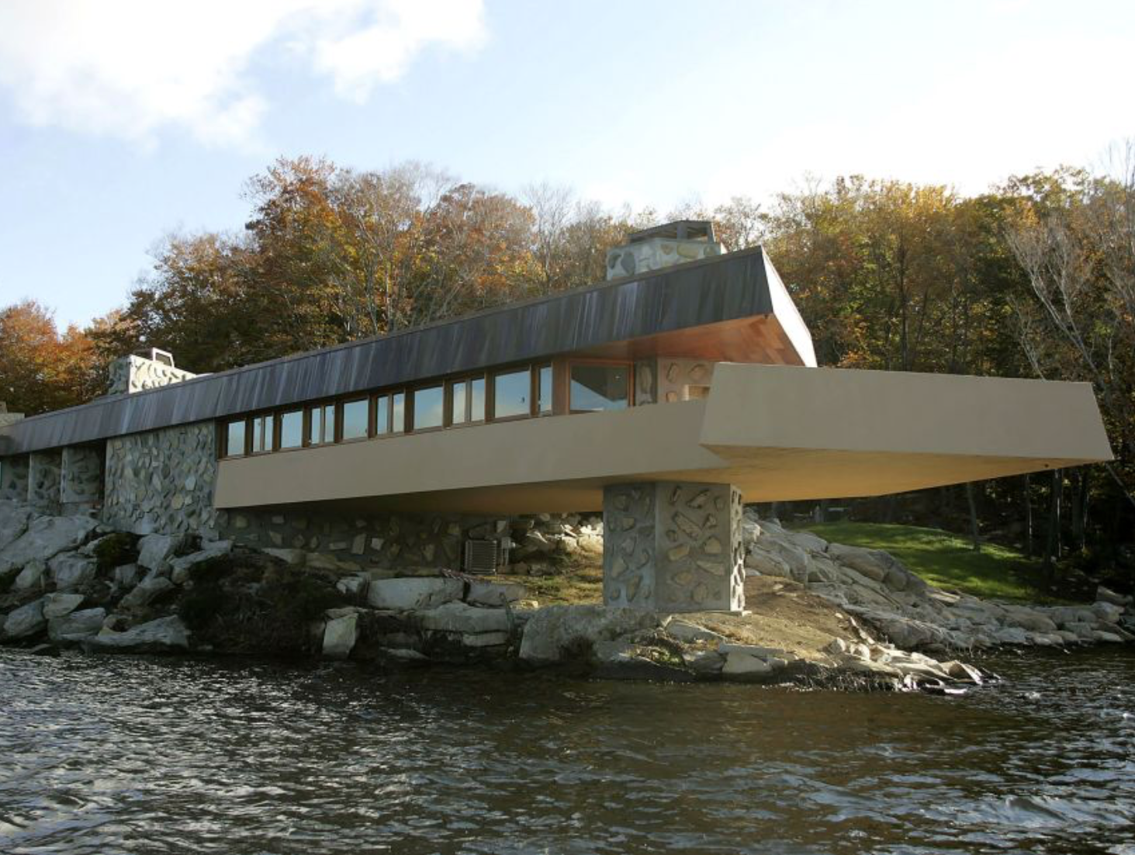
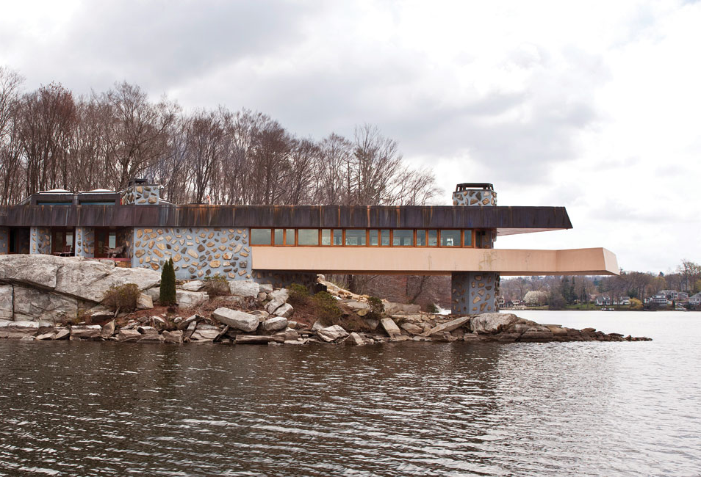
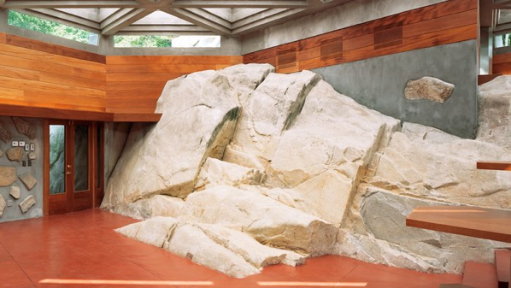
Massaro House, Petra Island, NY, 1949, 2003–2007
A private island residence designed by Wright in 1949. As designed it was known as the “Chahroudi House” for the client who commissioned it; as built in 2003–2007, it gained the name of its owner, Joseph Massaro.

Slide 14
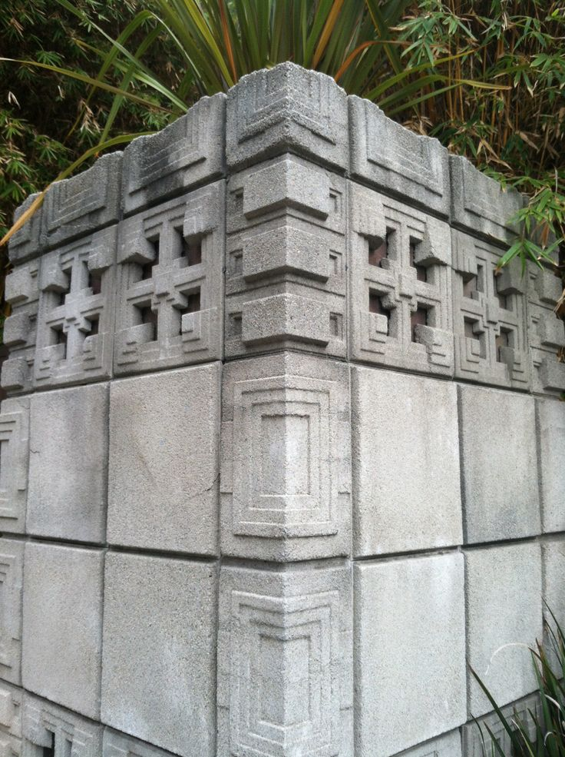
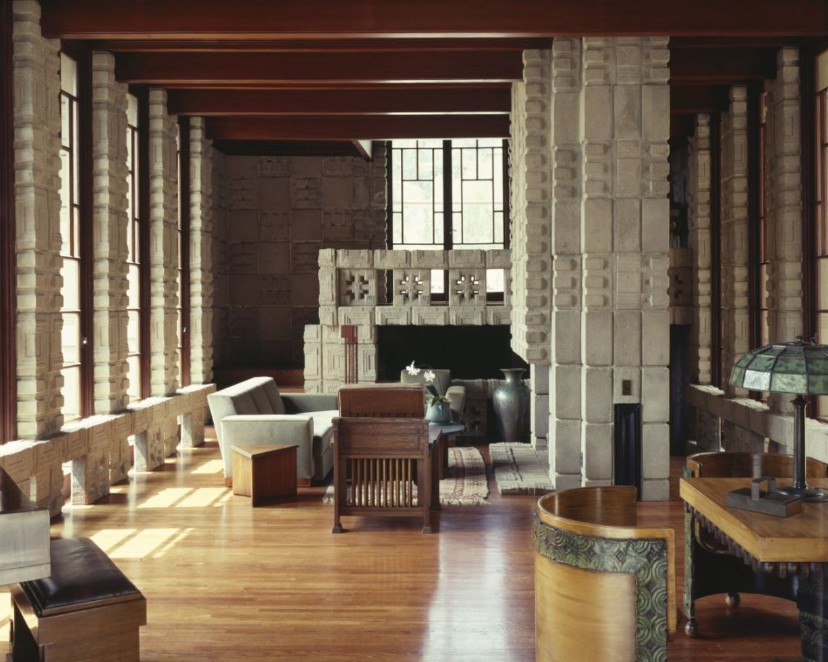
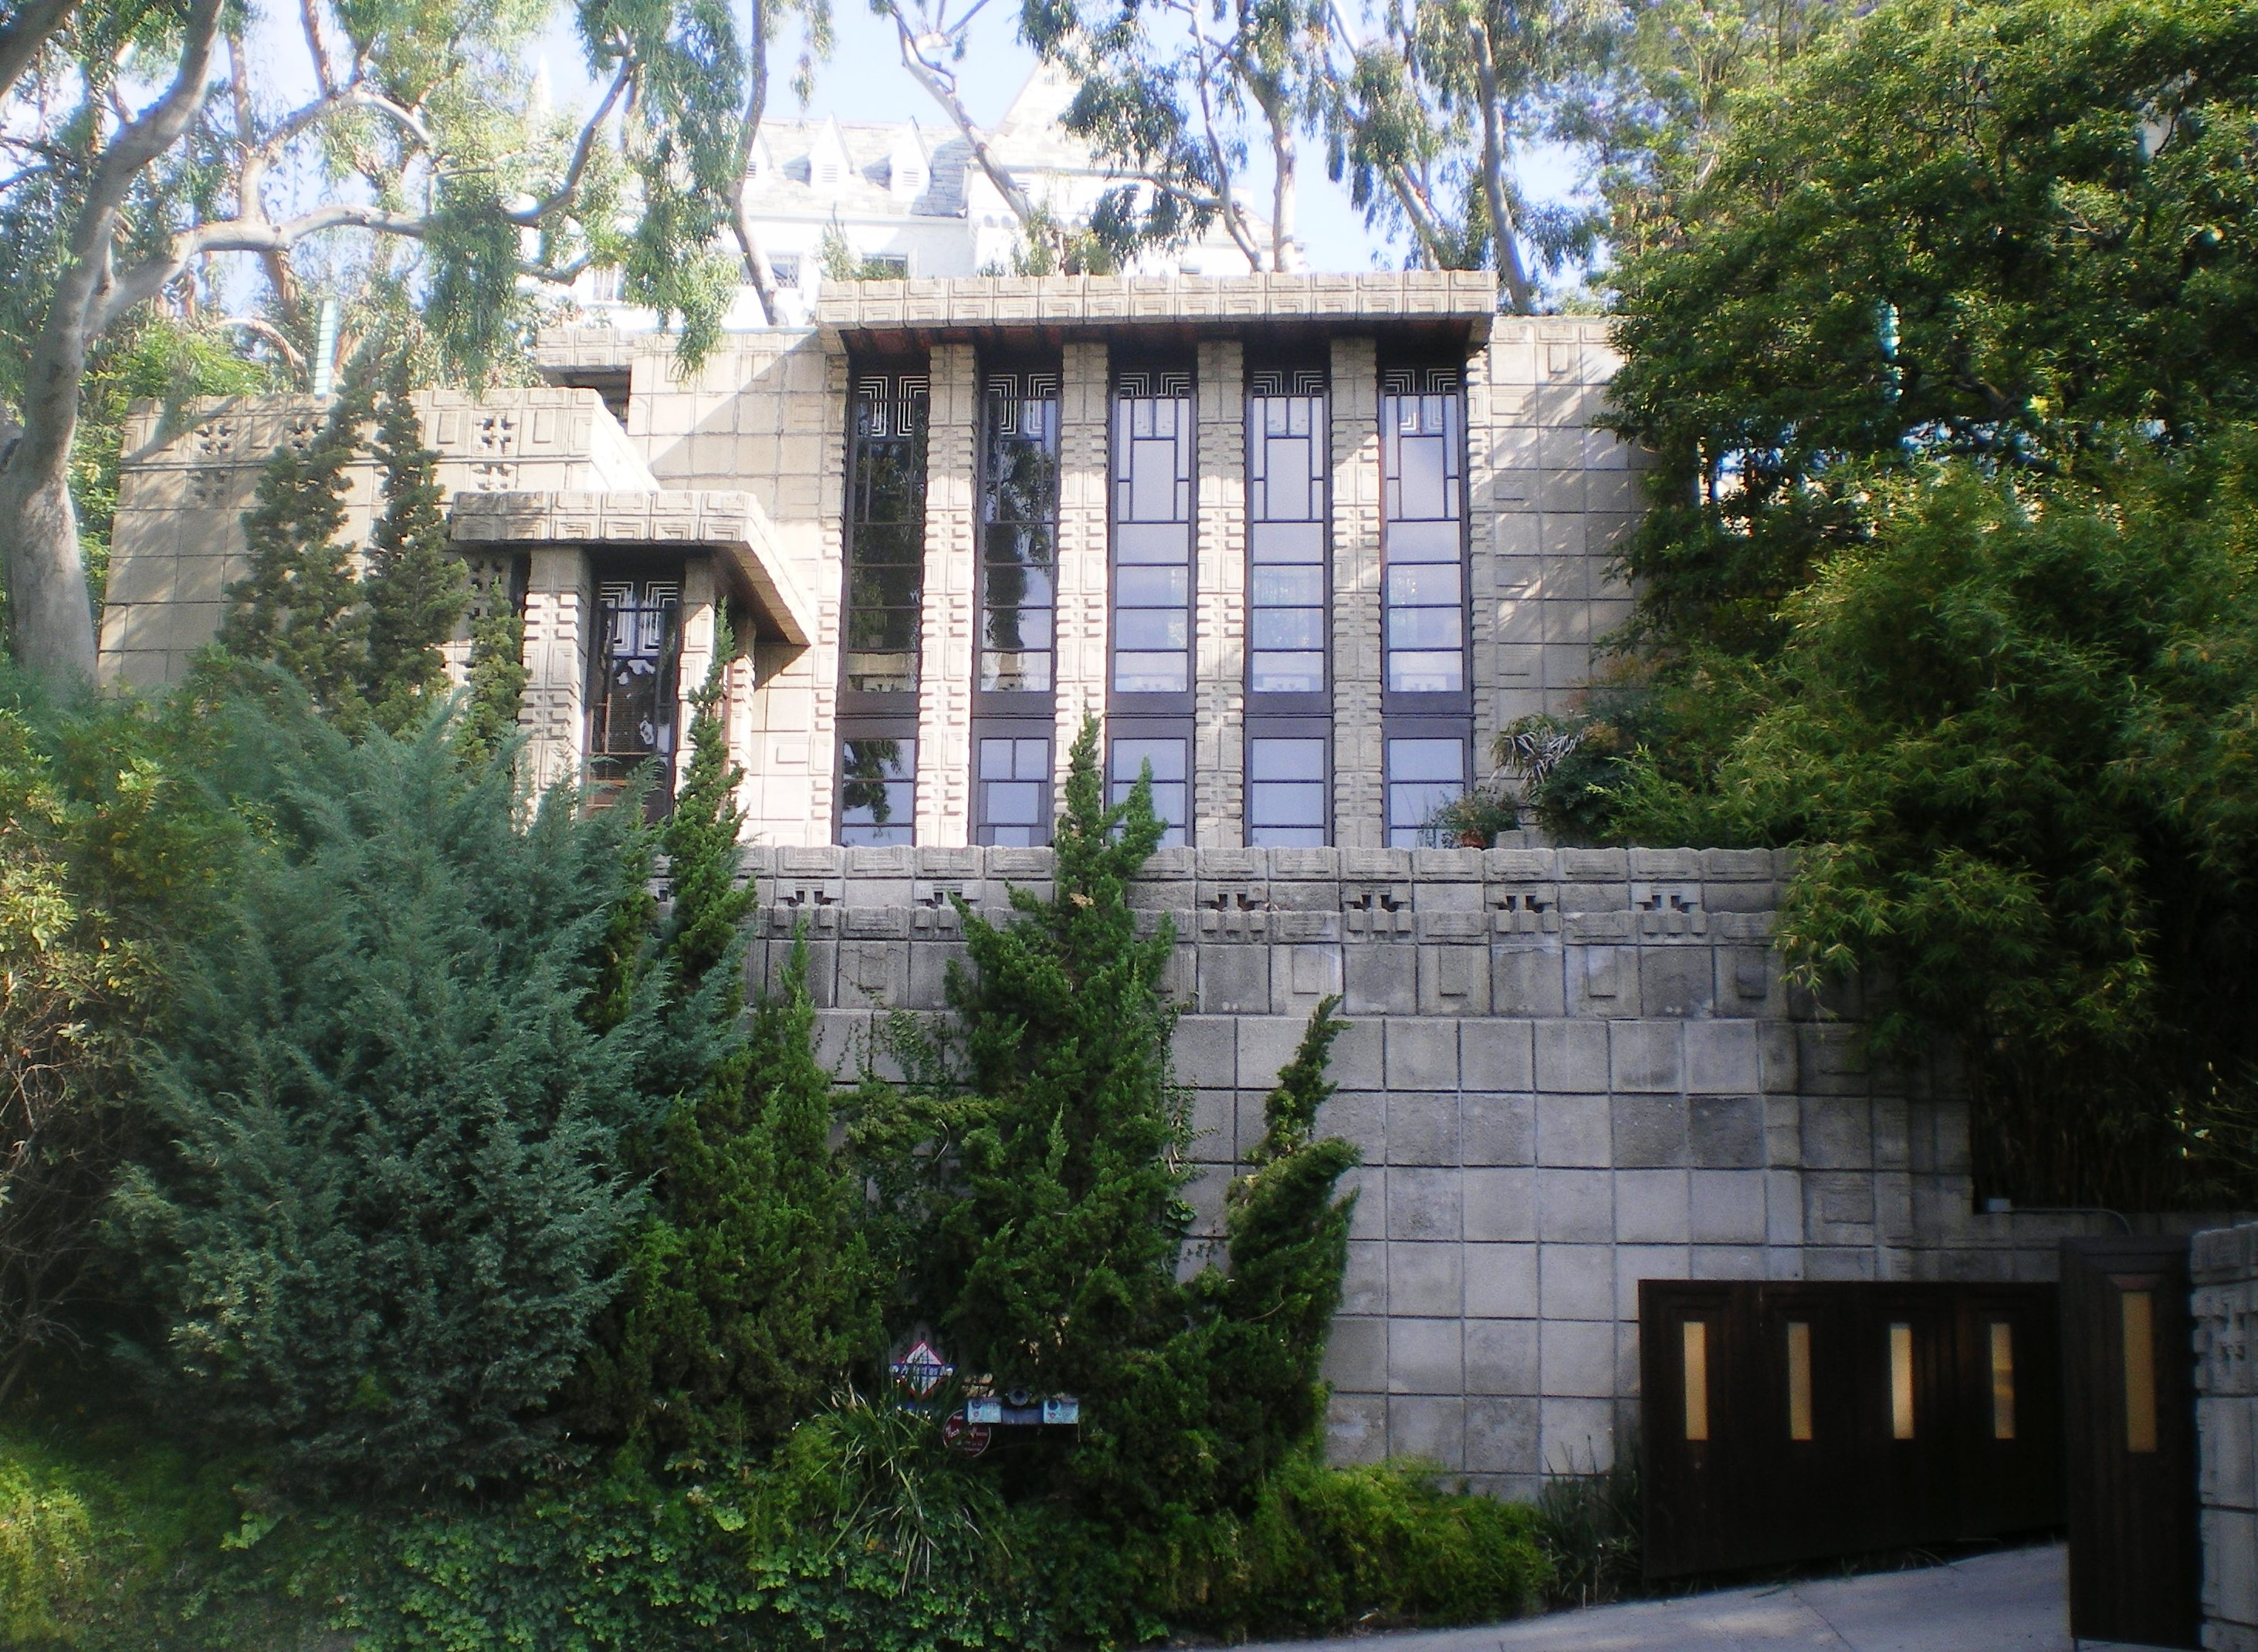
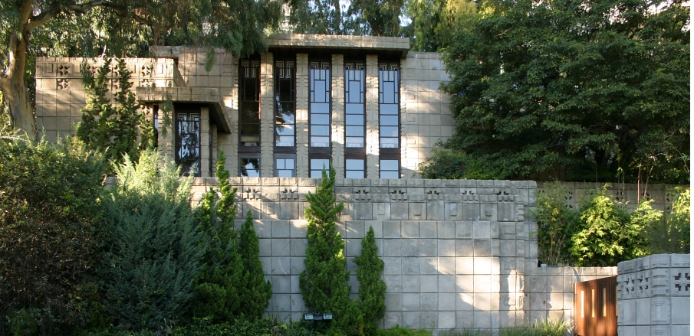
Storer House, LA 1922–24
The structure is noteworthy as one of the four Mayan Revival style textile-block houses built in the Los Angeles area. Wright used the textile-block motif to “fit” the home into the hillside, trying to create the impression that the home was “a man-made extension of the landscape.”

Slide 15
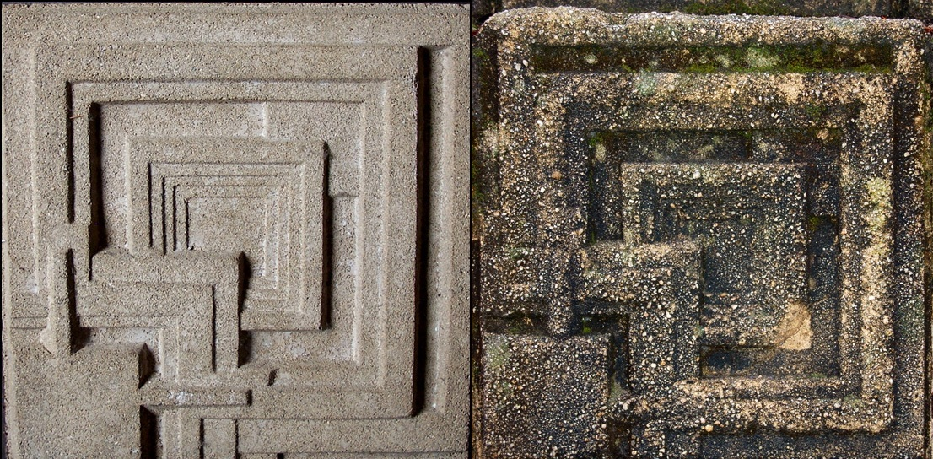
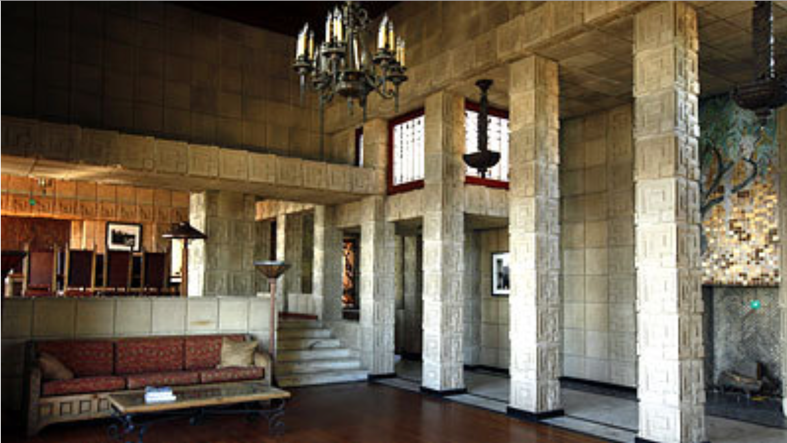
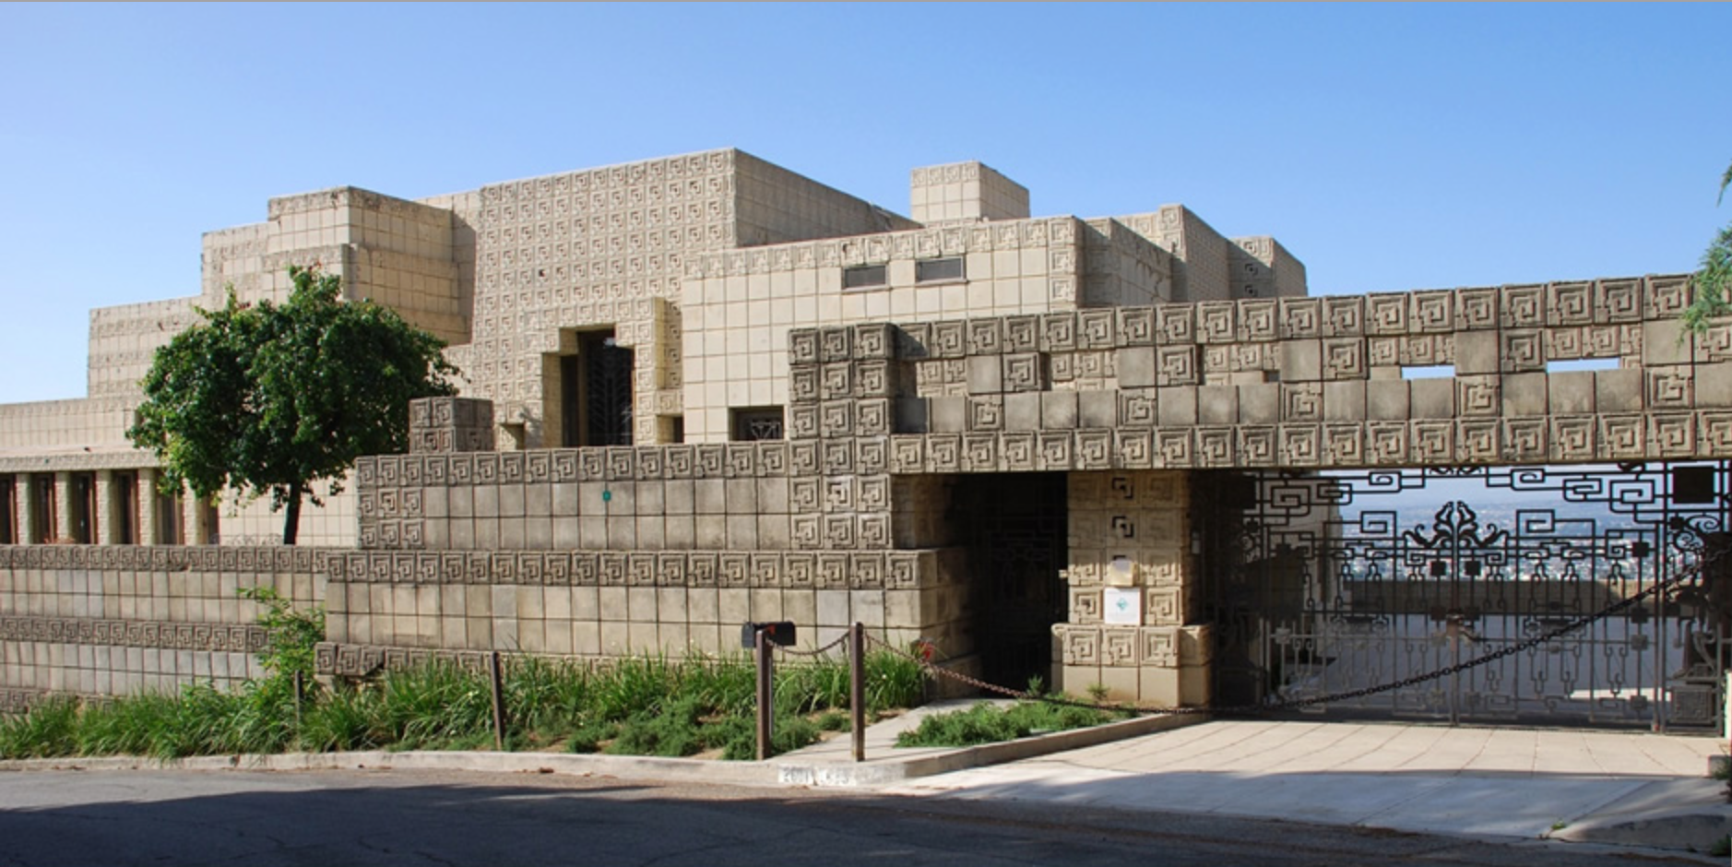
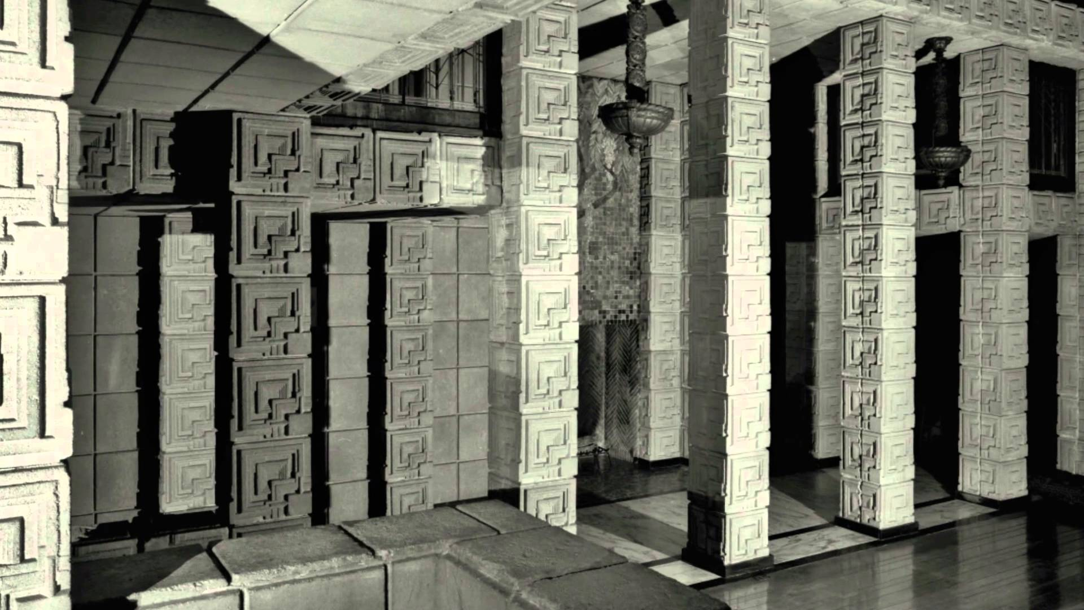
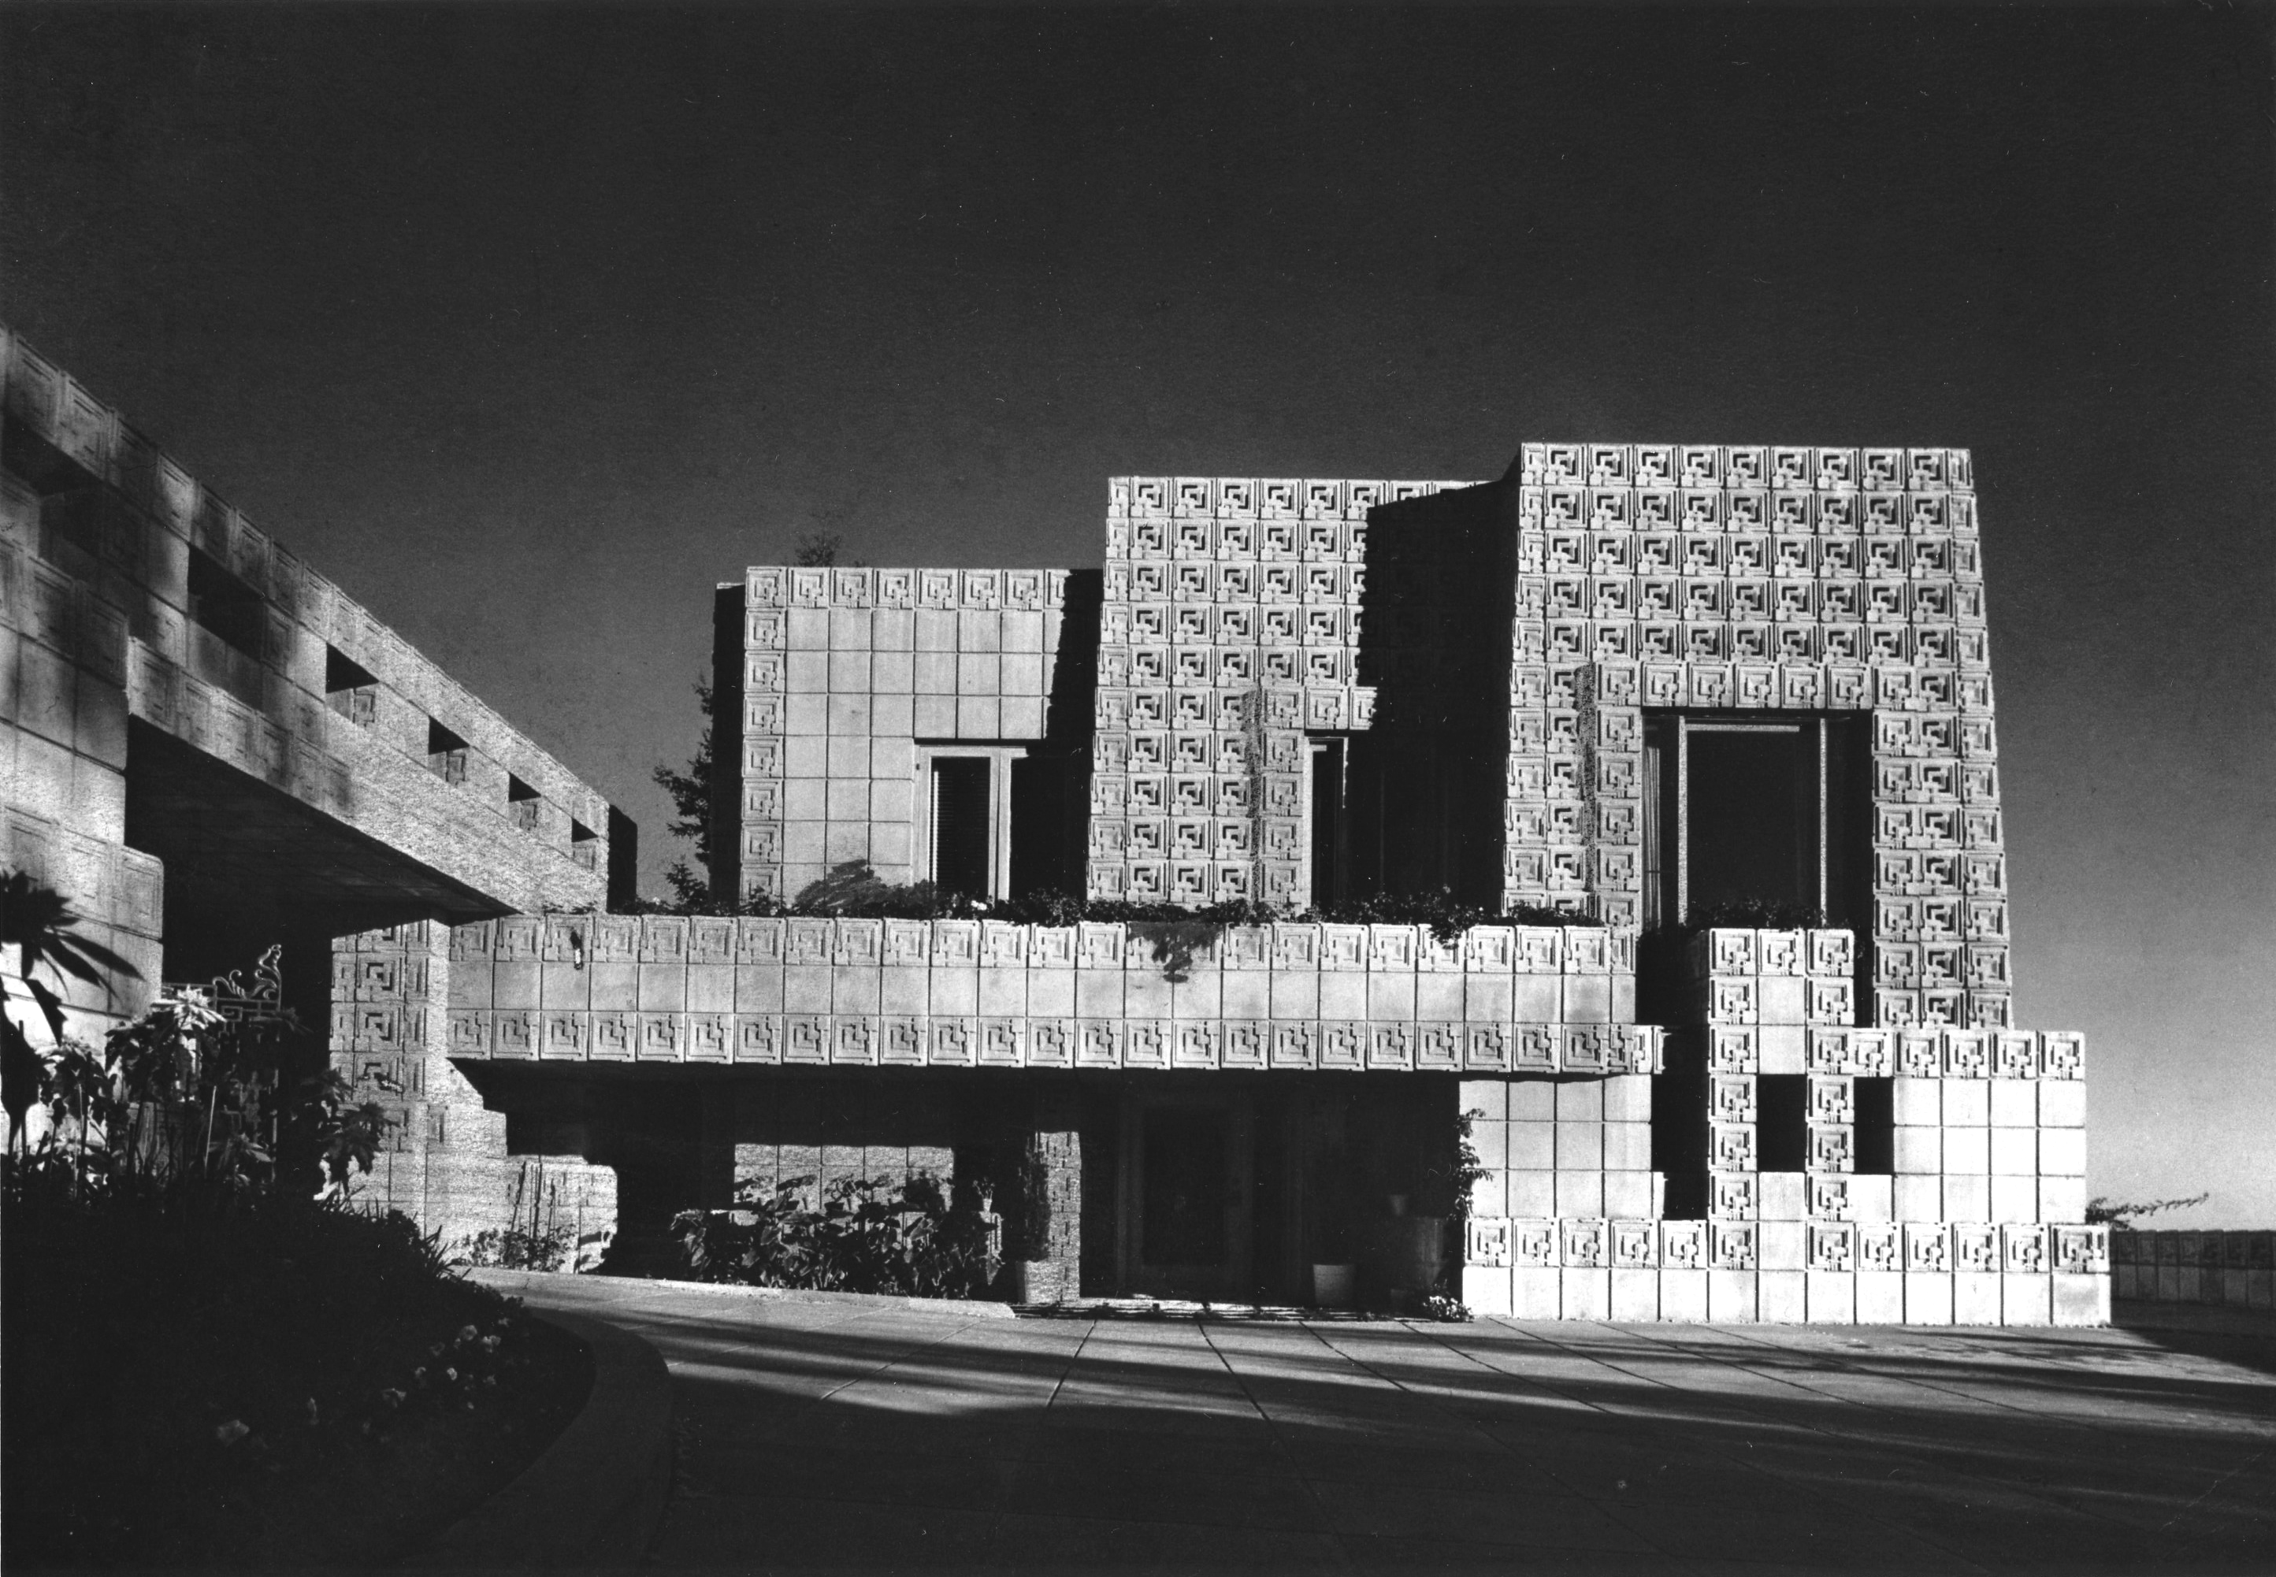
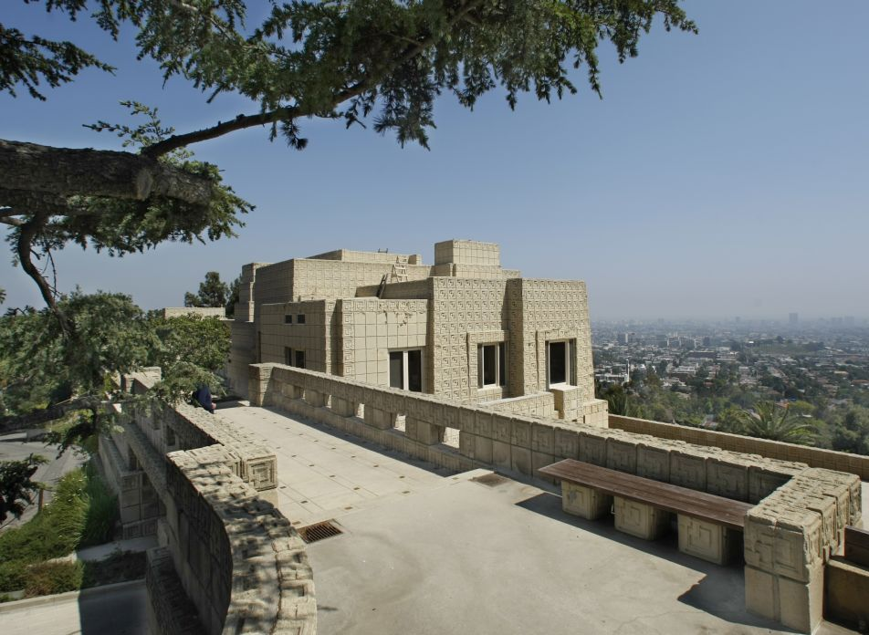
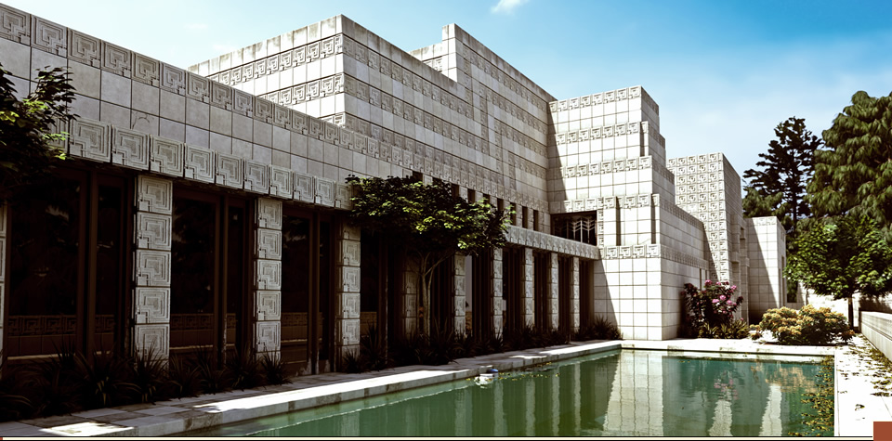
Ennis House, LA, CA, 1923–24
The design is the fourth and largest of Wright's textile block designs, based on ancient Maya temples and constructed primarily of interlocking pre-cast concrete blocks. It is sometimes referred to as an example of the Mayan Revival architecture. Its prominent detail is the relief ornamentation on its textile blocks, inspired by the symmetrical reliefs of Puuc architecture in Uxmal.

Slide 16

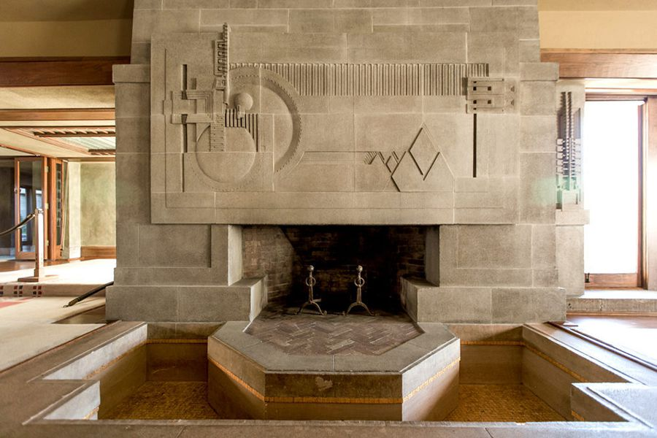
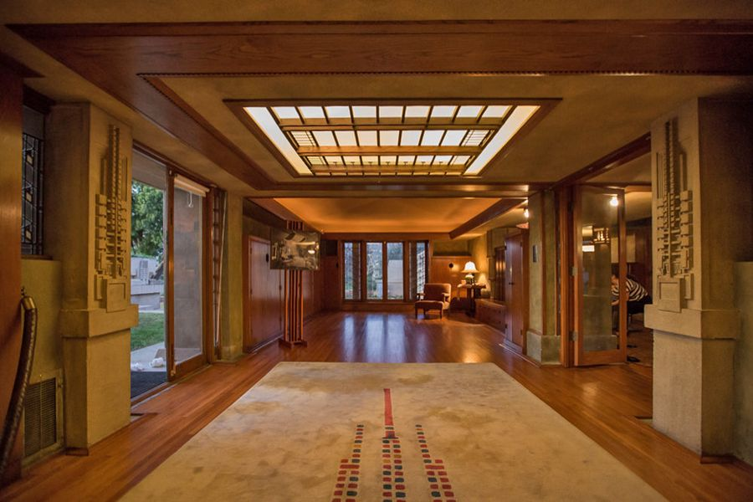
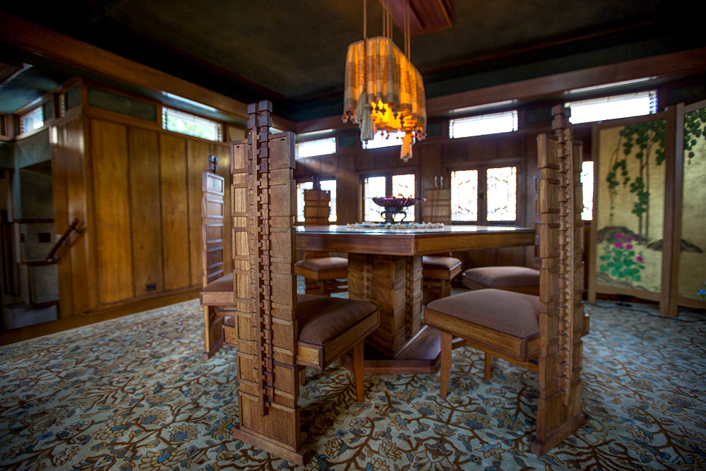
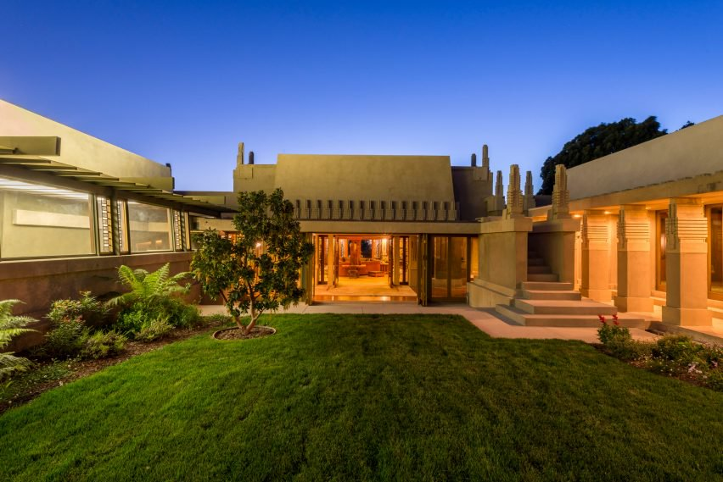
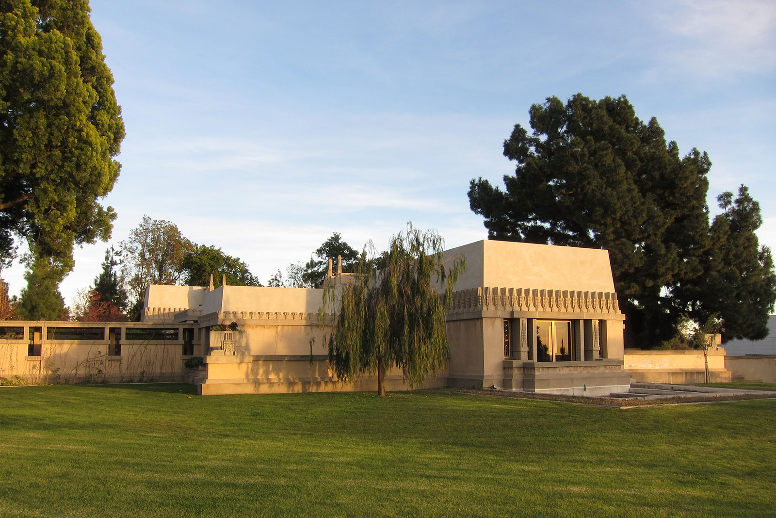
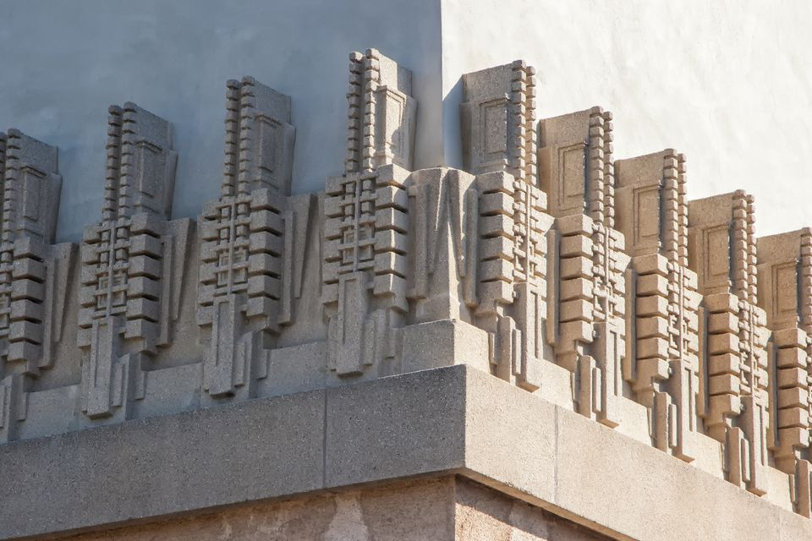
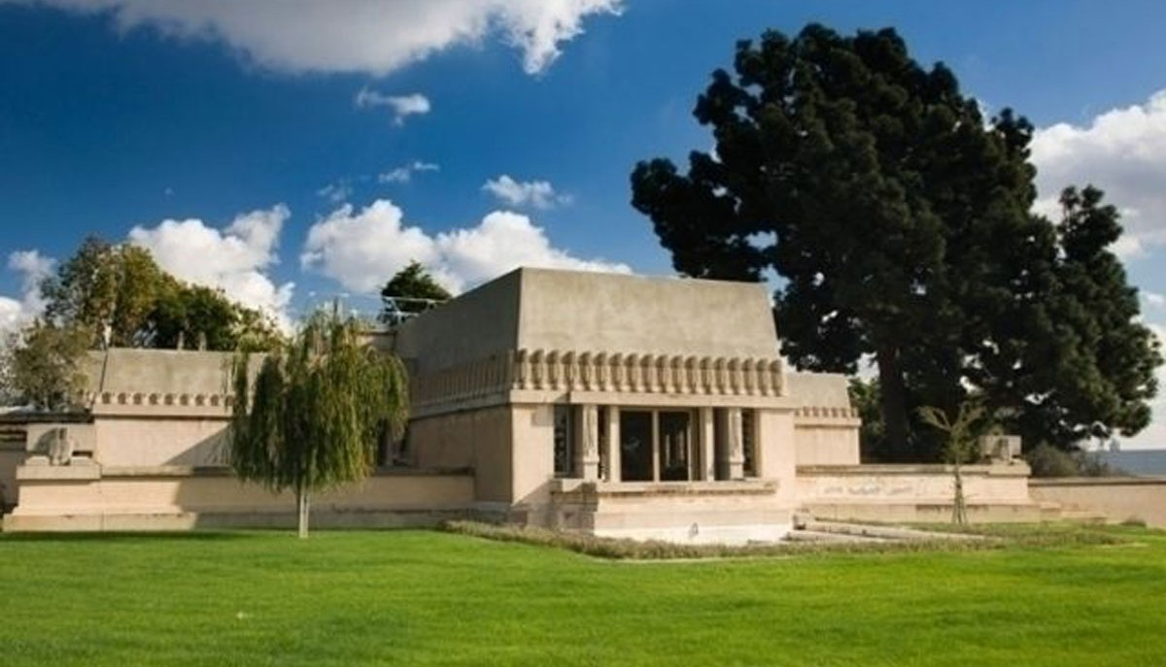
Hollyhock House LA, CA, 1919–1921
Called the harbinger of California modernism. The monumental hilltop home has open multipurpose rooms and eliminates the barrier between the interior and the exterior in many places. These are features that became synonymous with California living and residential design as a whole. “It began to change the way Americans used and lived in domestic interior spaces.”

Slide 17
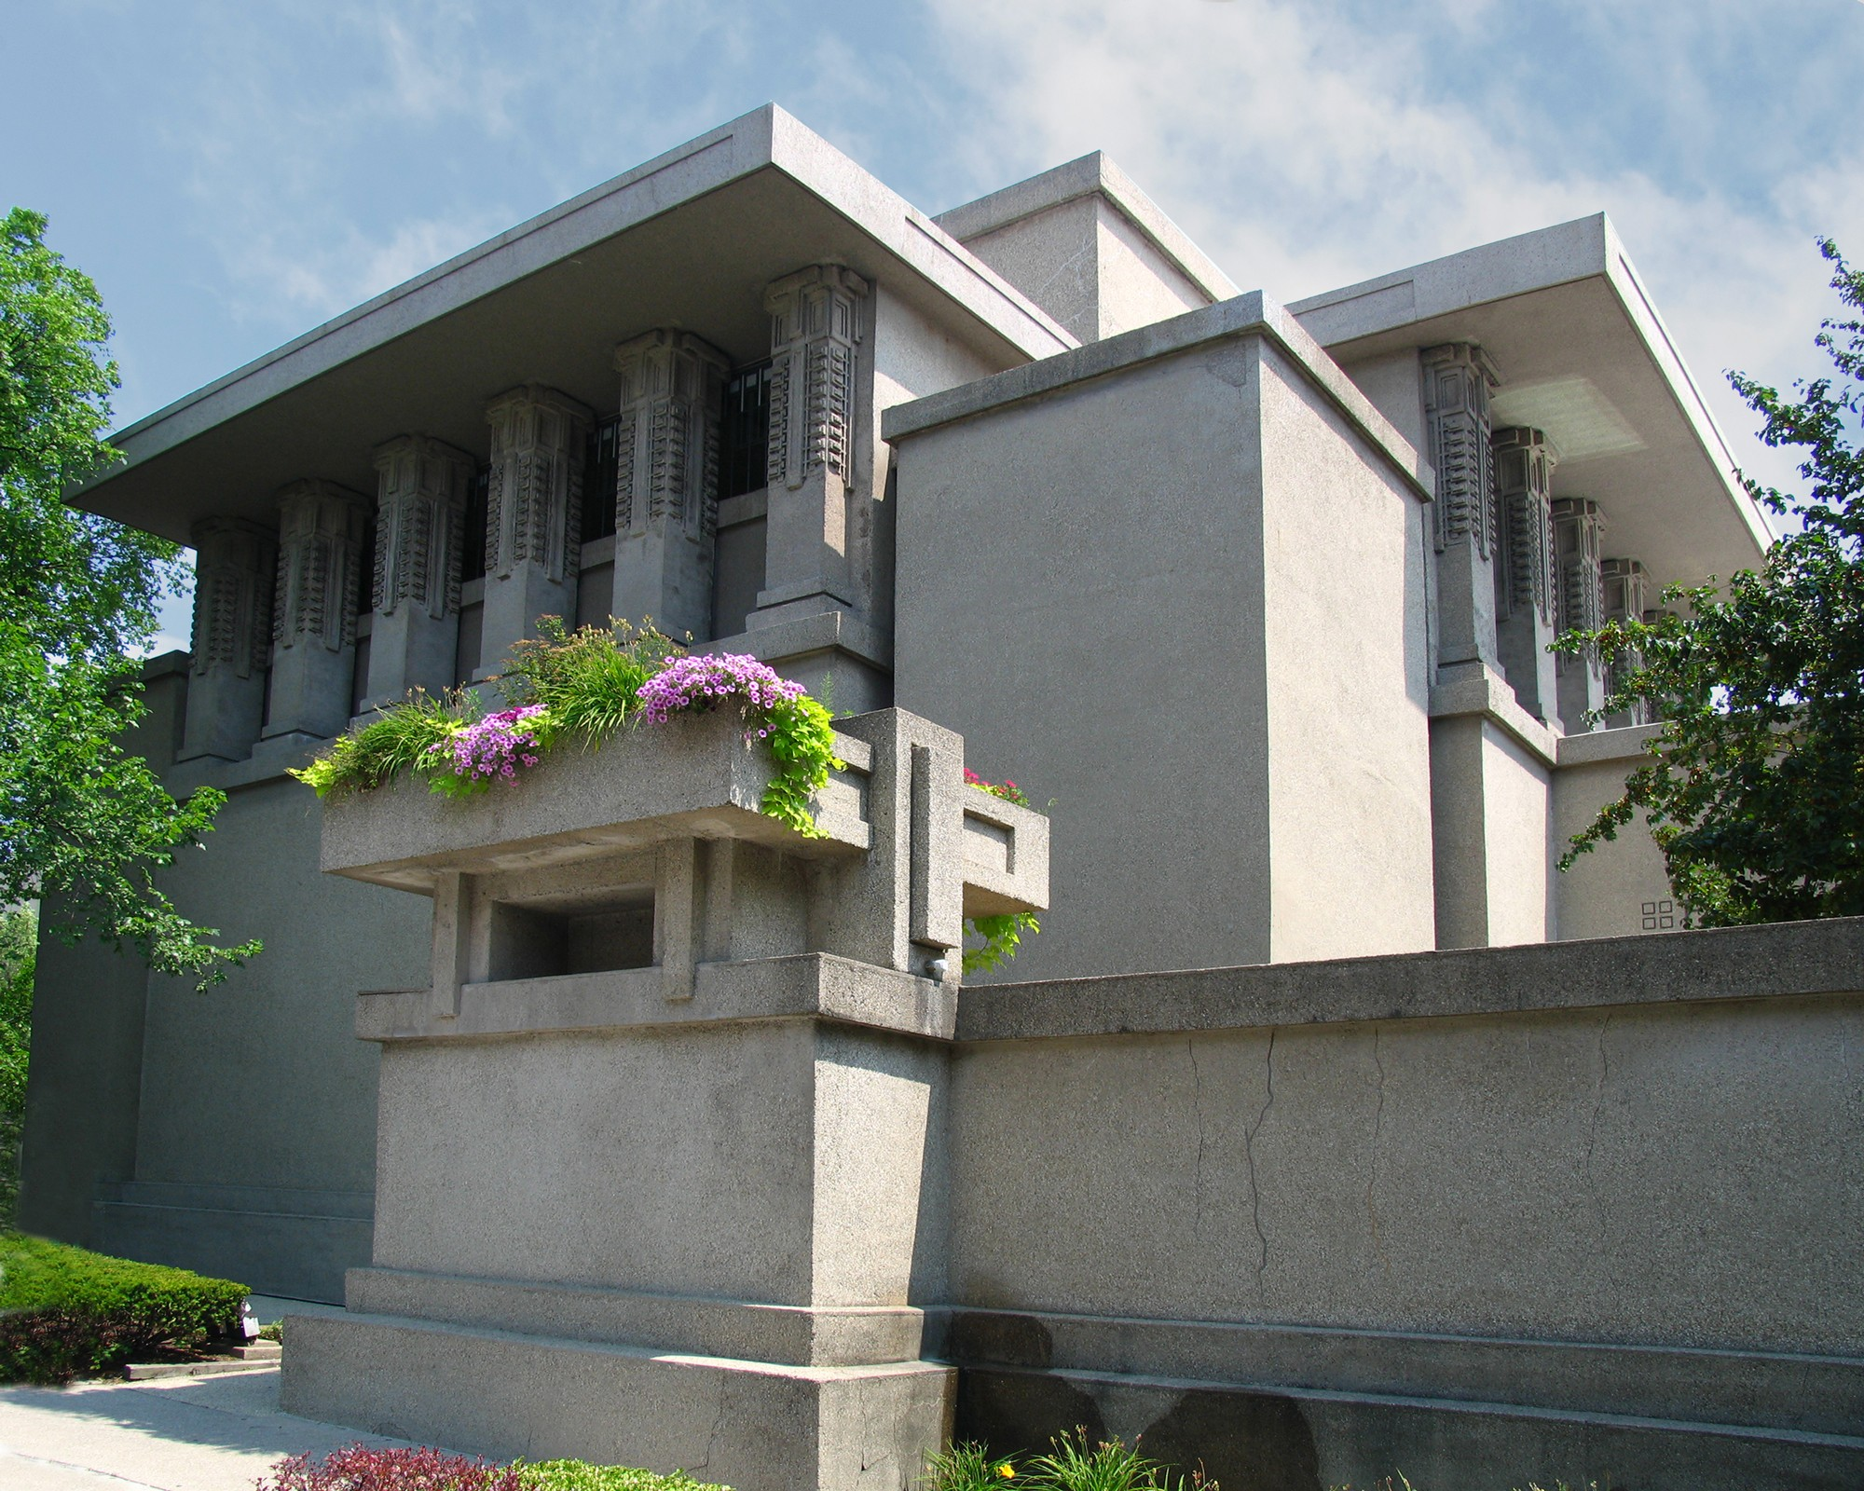
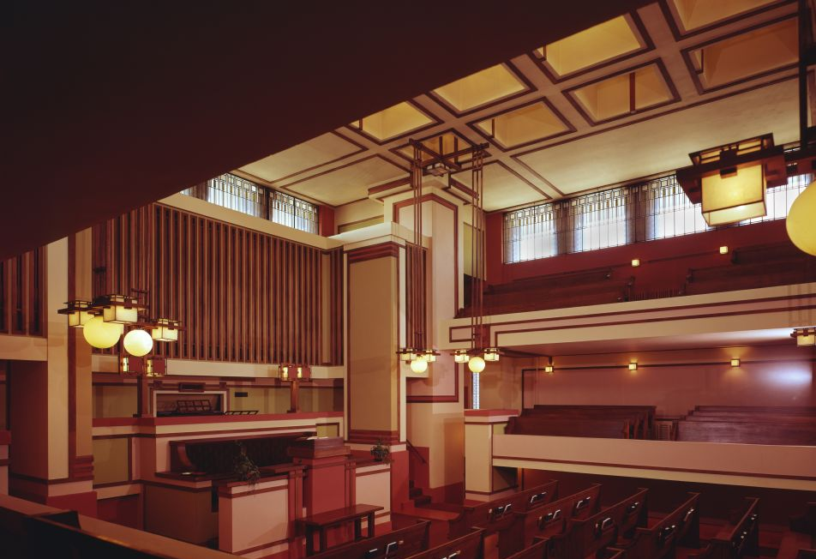
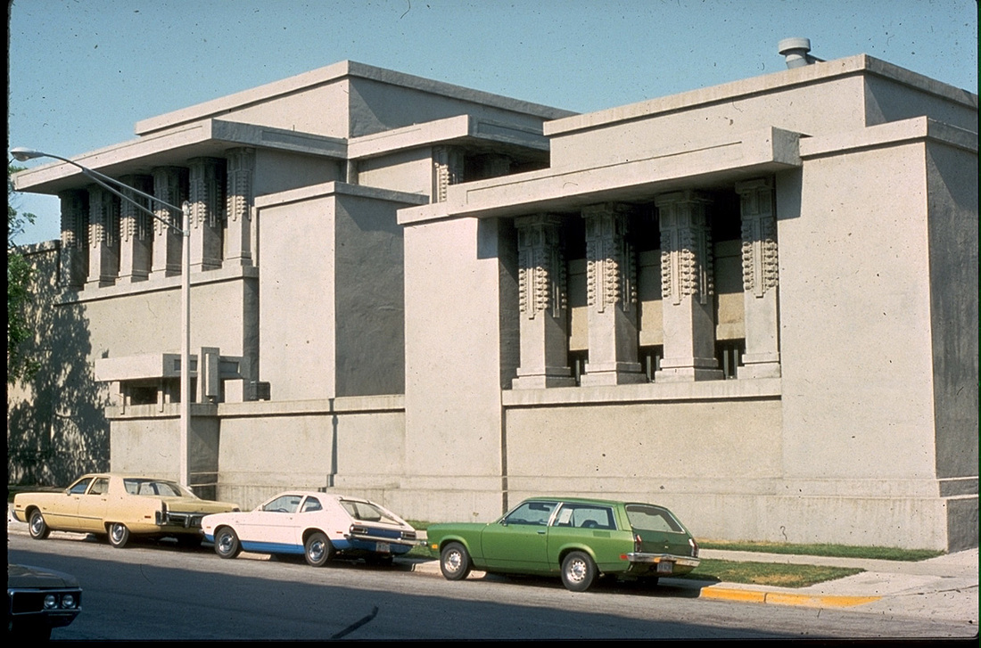
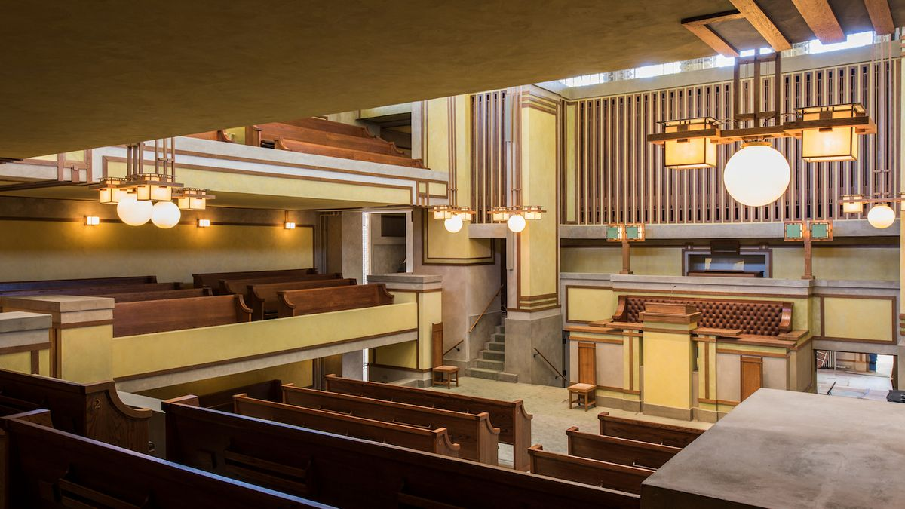
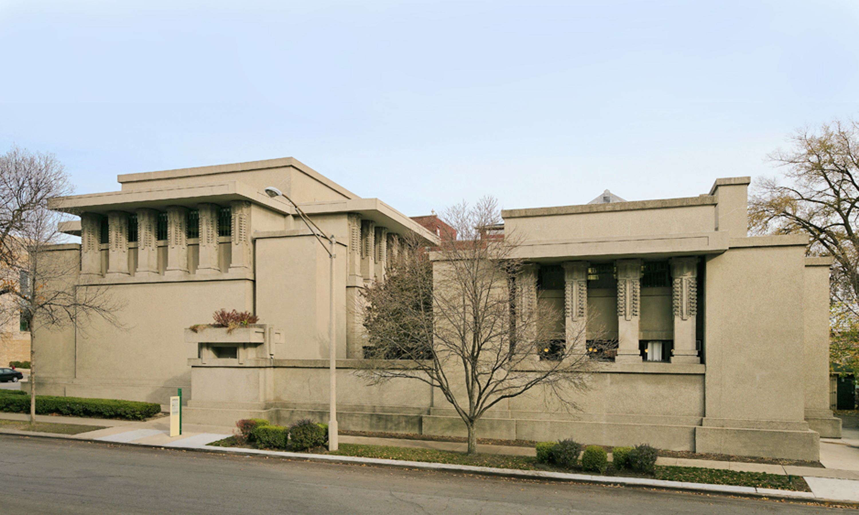
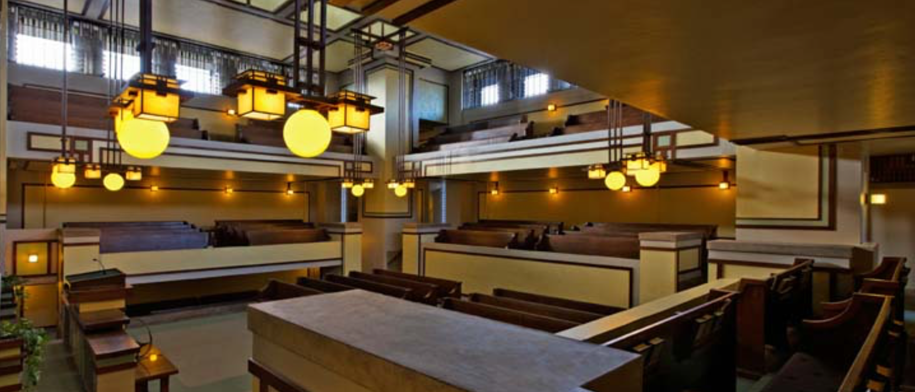
The Unity Temple Oak Park, Illinois, 1905–1908
Designed in Wright’s Oak Park Studio for his own Unitarian congregation, it is one of the first public buildings in America to feature exposed concrete and is Wright’s greatest public building of his Prairie Style era. The harmony of the building’s strikingly geometric architecture and decorative elements exemplifies Wright’s theory of organic design. Unity Temple announced a new era of innovation in modern architecture.

Slide 18

Ward Willits House, Highland Park, Illinois, 1901
Considered the first of the Prairie style houses. One of the more interesting points about the house is Wright's ability to seamlessly combine architecture with nature. The plan is a cruciate with four wings extending out from a central fireplace. In addition to stained-glass windows and wooden screens that divide rooms, Wright also designed most of the furniture in the house.

Slide 19


The William G. Fricke House, Oak Park, Illinois, 1901–02
In these early works, Wright is experimenting more and more with furniture designed by him as to his dismay, noted that clients –moved in with their antique furniture.
Using fixed shelves, chairs, sideboards, wardrobes, etc.. ensured that at least basic furniture was in line with the overall design. The architecture of the garden was based on the building, in order to give an impression of unity.

Slide 20

Robie House, Chicago, Illinois 1909
Robie House is the consummate expression of the Prairie style—conceived as an integral whole—site and structure, interior and exterior, furniture, ornament and architecture, each element is connected. Unrelentingly horizontal in its elevation and a dynamic configuration of sliding planes in its plan, the Robie House is the most innovative and forward thinking of all Wright’s Prairie houses.

Slide 21


Taliesin West Scottsdale, Arizona 1937
Wright’s beloved winter home and the bustling headquarters of the Taliesin Fellowship, was established in 1937 and diligently handcrafted over many years into a world unto itself. Deeply connected to the desert from which it was forged, Taliesin West possesses an almost prehistoric grandeur. It was built and maintained almost entirely by Wright and his apprentices, making it among the most personal of the architect’s creations.

Slide 22


The Rookery Building Chicago, Illinois 1905
Set in the heart of Chicago’s financial district, Daniel Burnham and John Root’s 1888 Rookery Building is a Chicago landmark, containing one of Frank Lloyd Wright’s most dramatic interior compositions – a luminous and brilliantly articulated central light court. In 1905, Wright was commissioned to remodel the Rookery light court and lobbies. He realized a stunning balance between Burnham & Root’s ornamental ironwork and his own vision to create a spectacular environment.

Slide 23

Johnson Wax Research Tower Racine, Wisconsin, 1936–39, 1950
The Research Tower was Wright’s vision of a vertical compliment to the Administration Building. The Research Tower is one of the tallest structures ever built on the cantilever principle.

Slide 24


Marin County Civic Center, San Rafael, CA, 1957–1962
The Marin County Civic Center was Frank Lloyd Wright's last commission and largest public project. It is one of a very few state-sponsored buildings designed by Wright. Government buildings always seem to demand your attention to their skyward thrust; Wright's design here eschews that for the long, low and horizontal curve that embraces the ground and melds with the hills to the east.

